Slide 1
Porthpean SC Historical Photos

Slide 2
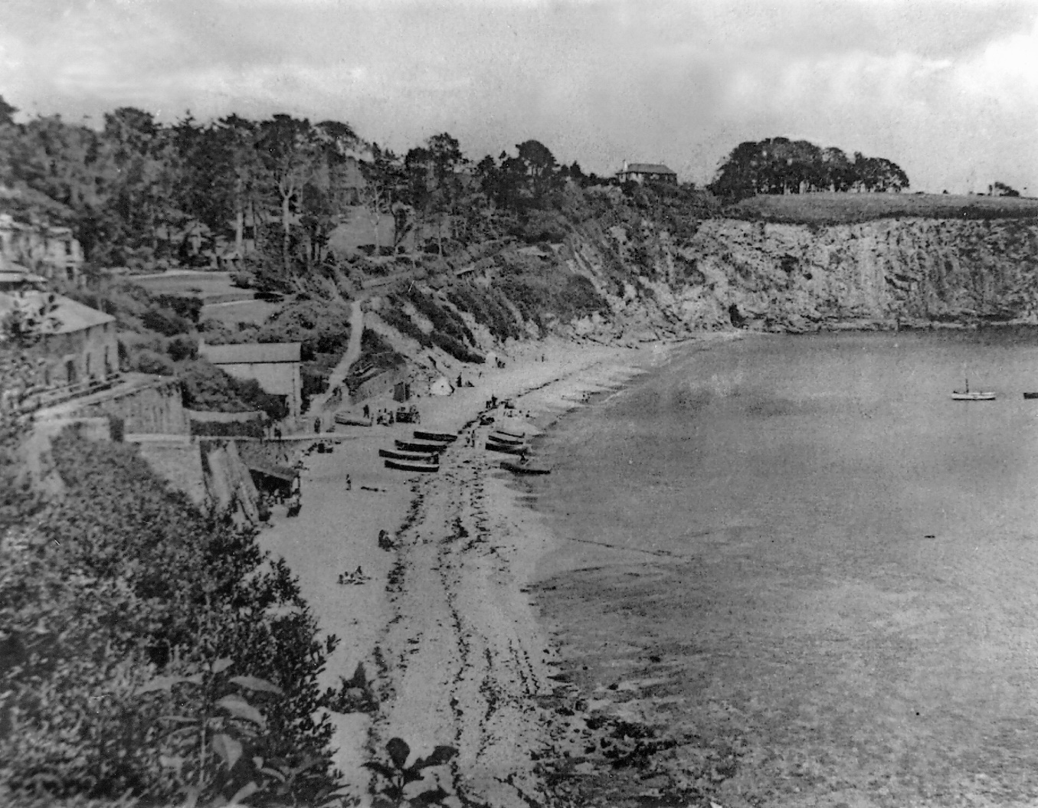
Once upon a time – with pilchard sheds and fewer trees...

Slide 3
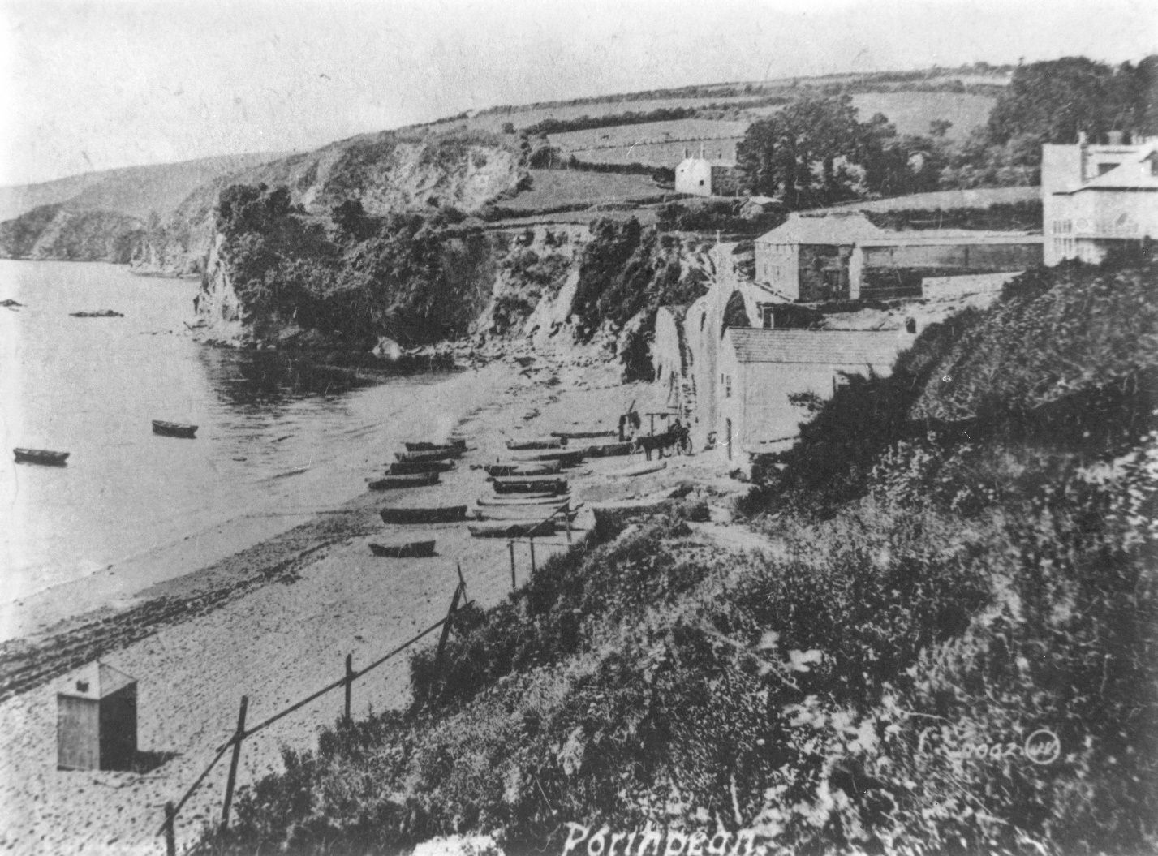
Even fewer trees this side...

Slide 4
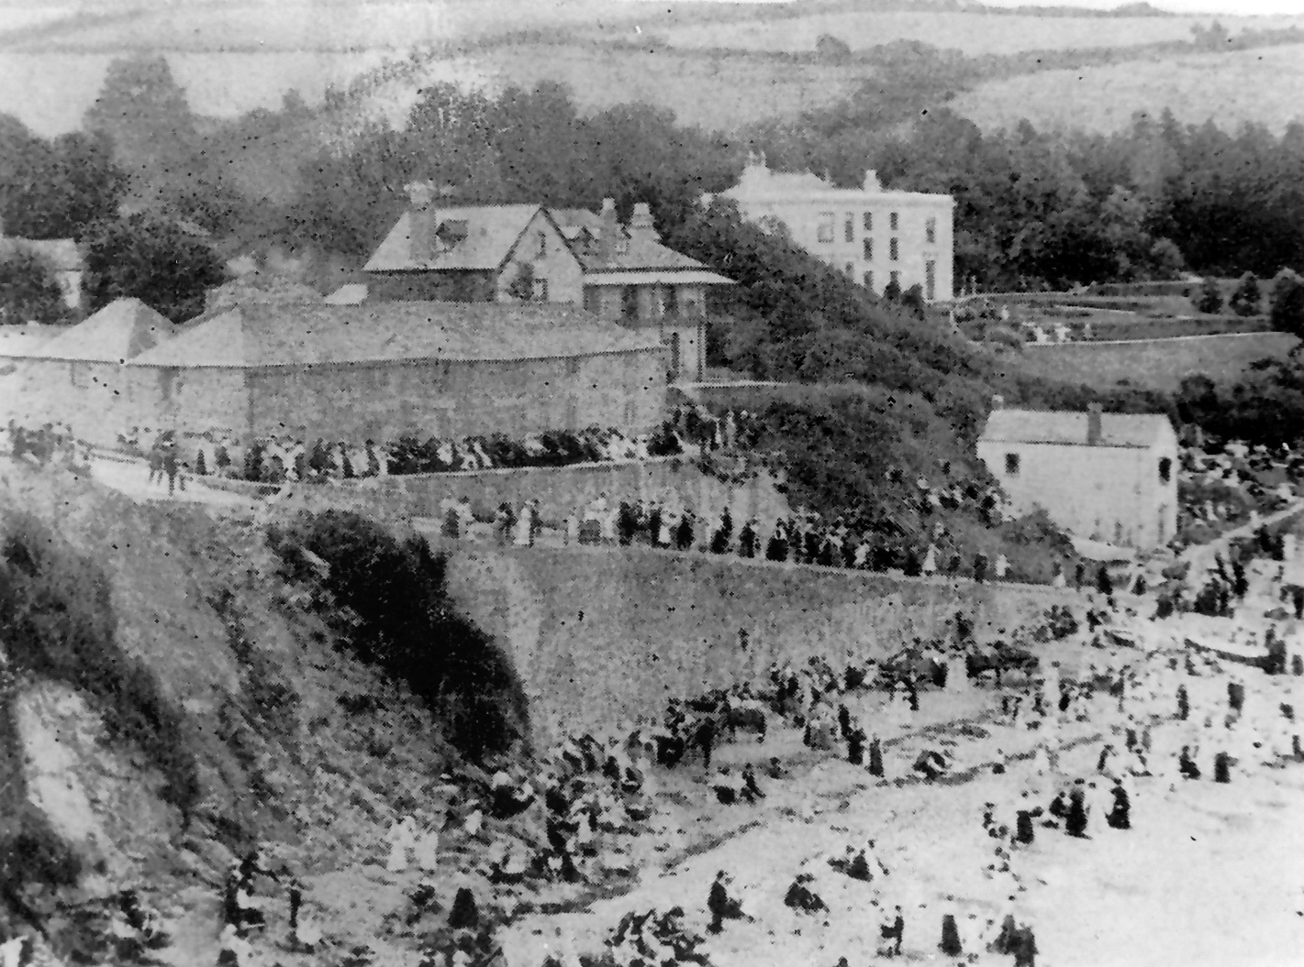
The beach never used to be this crowded….

Slide 5
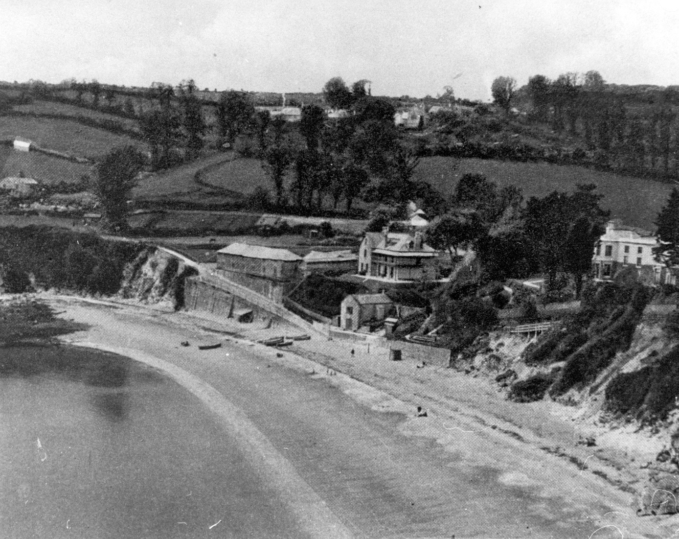
Then (early 1900s?)

Slide 6
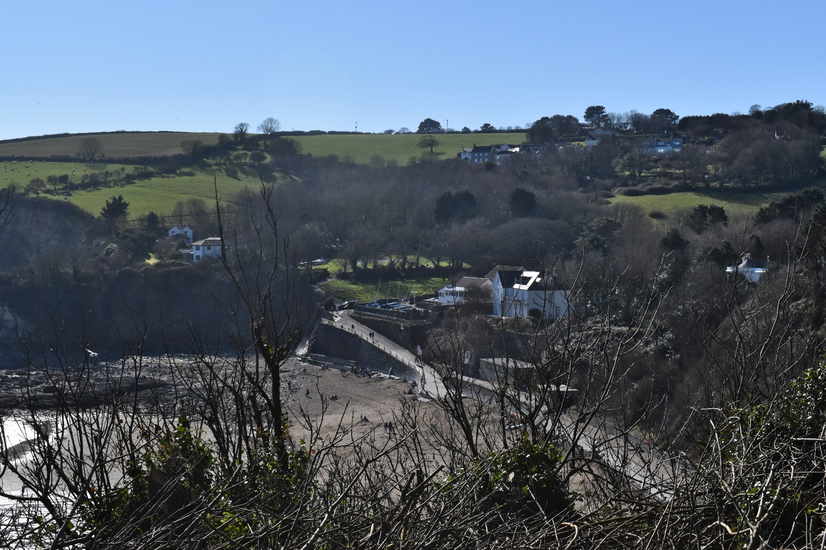
Now – well about a month ago

Slide 7
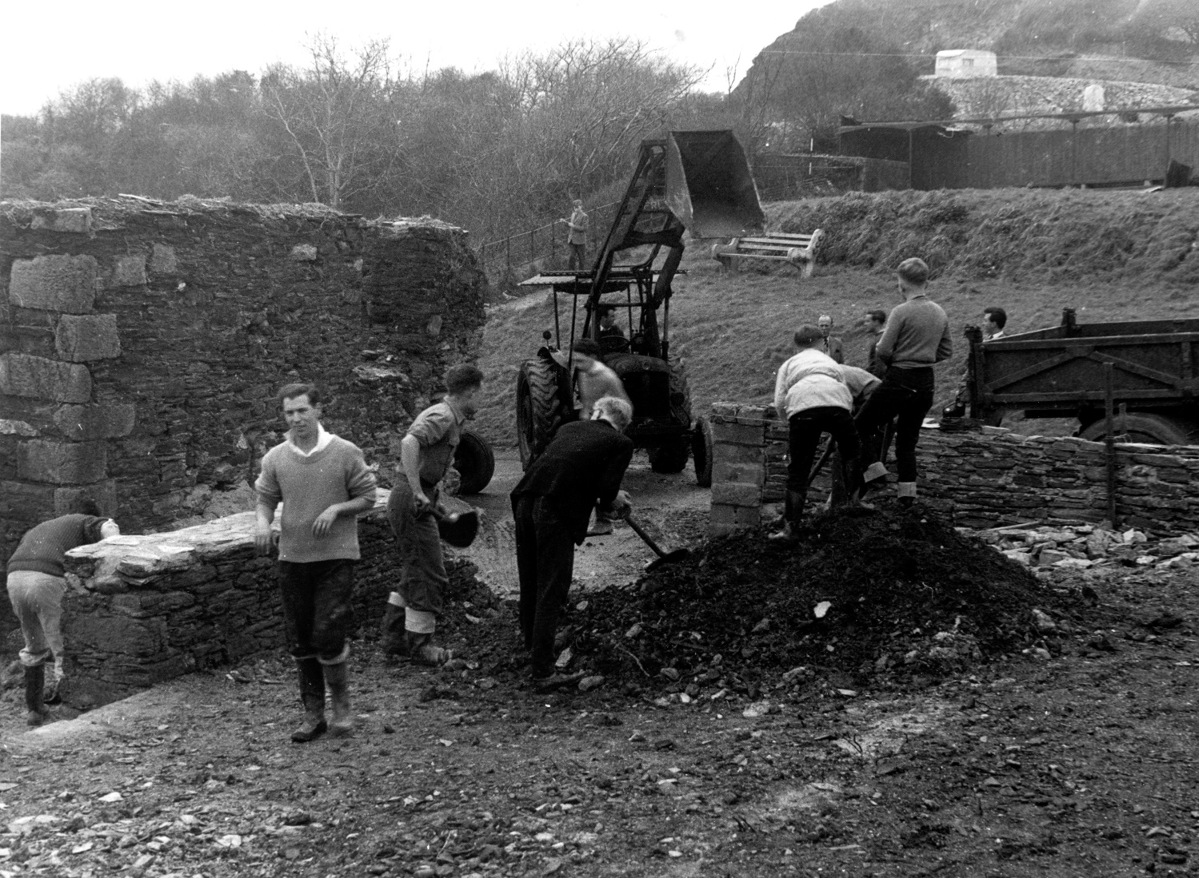
Boatyard Gateway – Green looks a bit different!

Slide 8
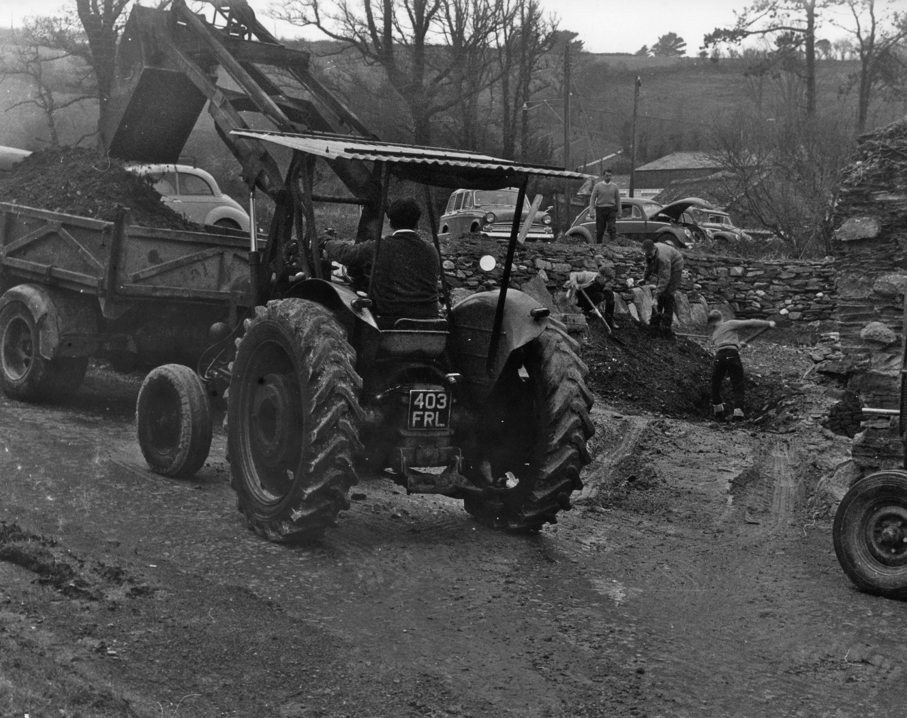
Tractor with old style Cornish registration and typical Cornish engineering solution for cab!

Slide 9
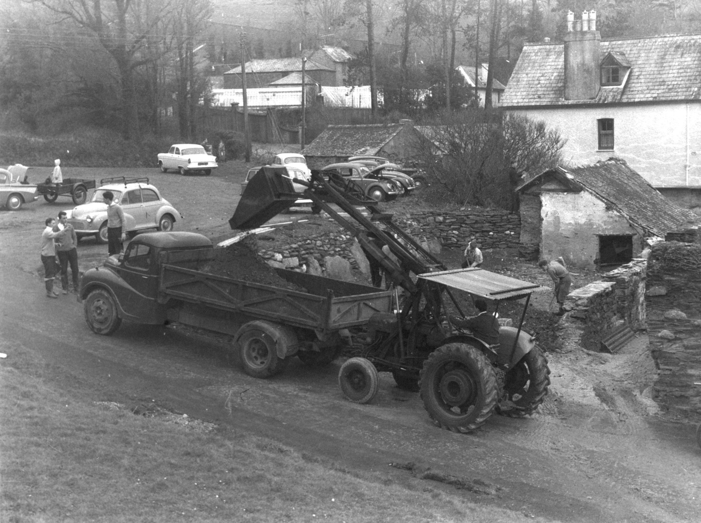
Gateway and Laser parking area – note works supervisor standing in trailer in the background.

Slide 10
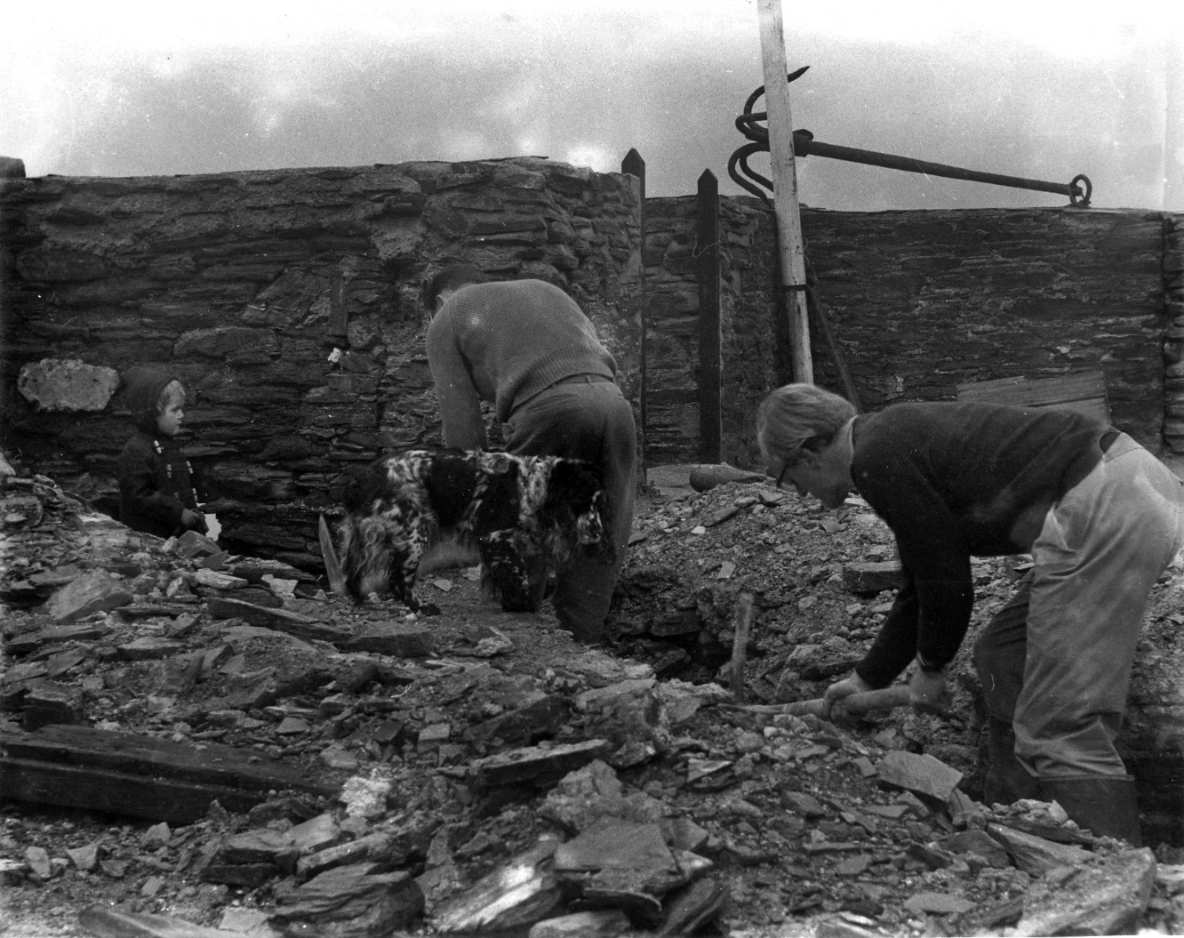
There’s always a perishing dog ‘helping’…..

Slide 11
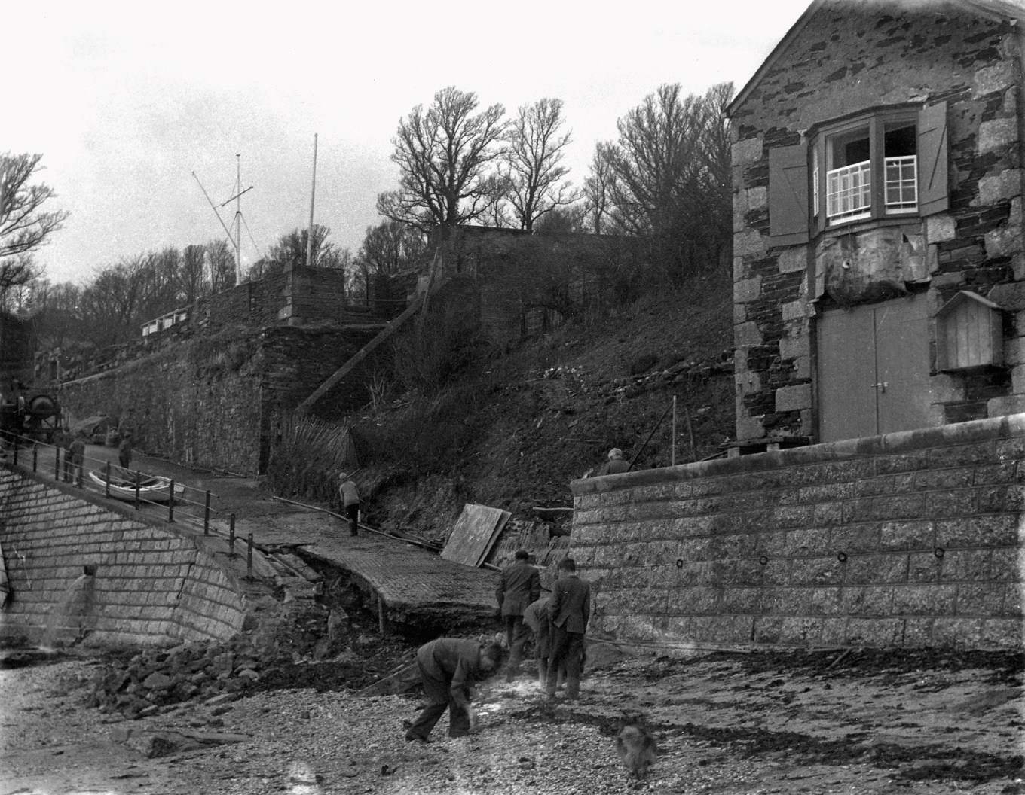
Damage to the slipway not a new problem then! Does anyone know if the Council did the repairs or did the club do it?

Slide 12
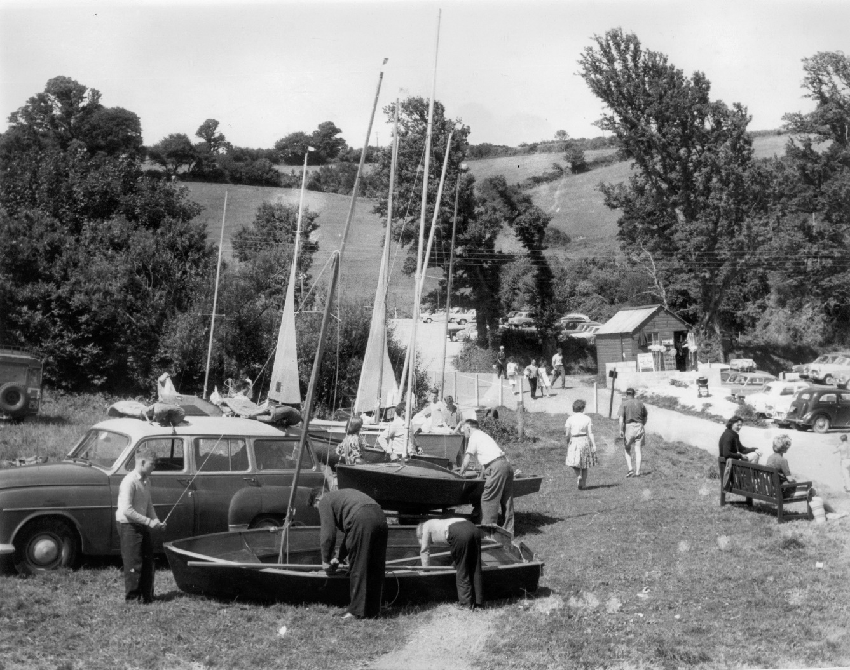
Presume that’s a small shop in the corner of Mrs Petherick’s garden? Anyone know what the boat in the foreground is – or the car?

Slide 13
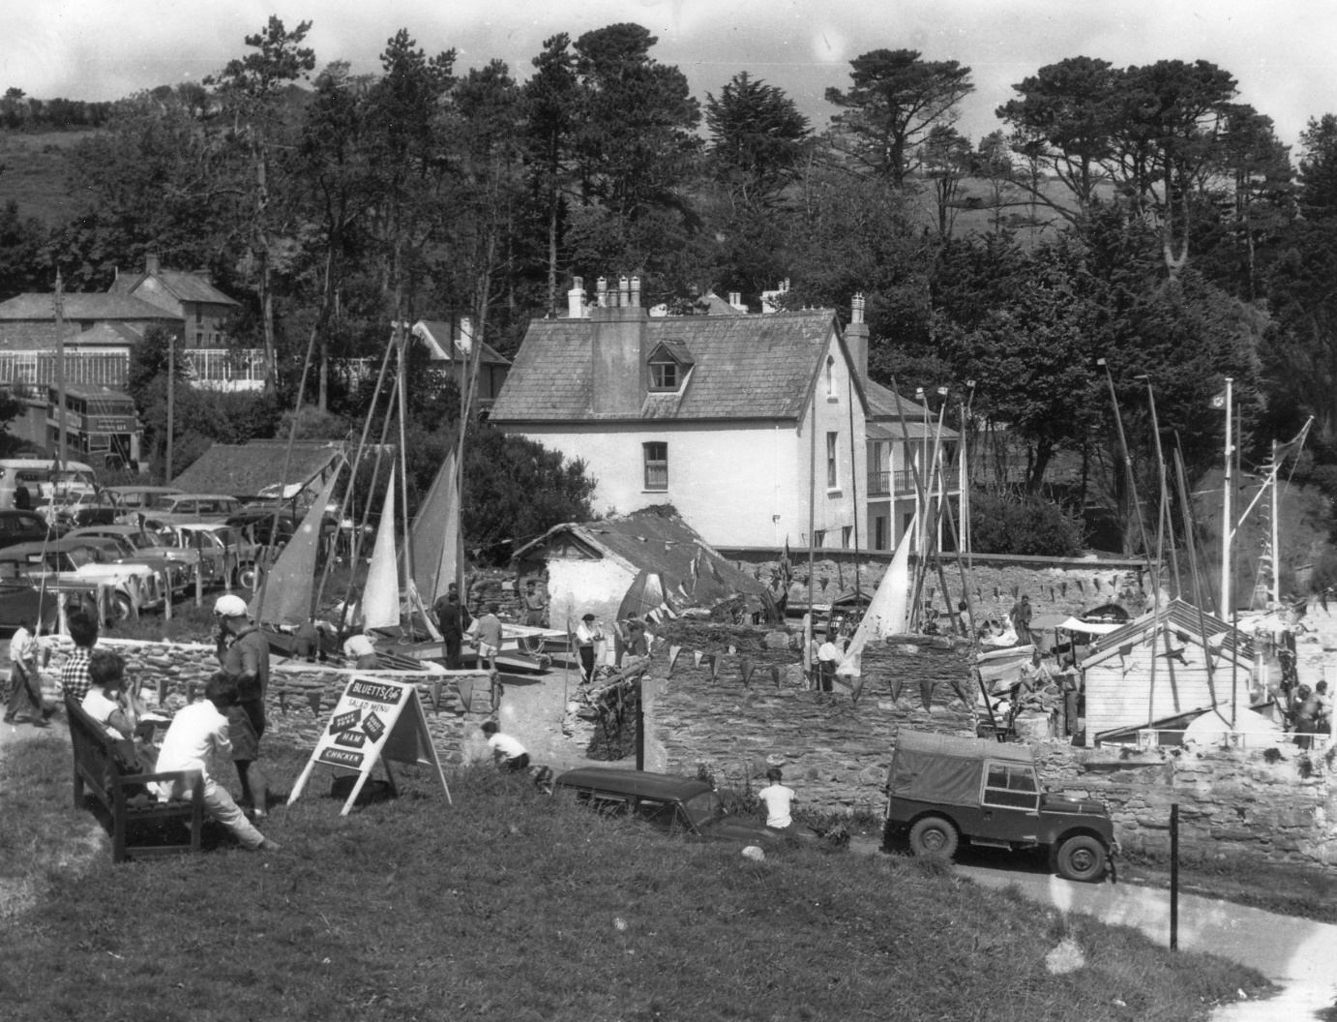
Regatta day – late 1950s??

Slide 14
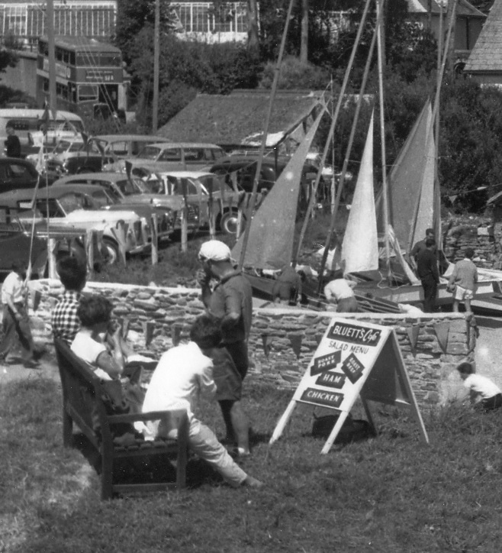
Bluett’s cafe salad menu and there’s a bus!! Is that a knotted hanky on his head?

Slide 15
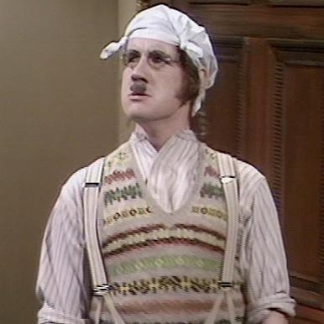
Ah yes, knew I’d seen him before...

Slide 16
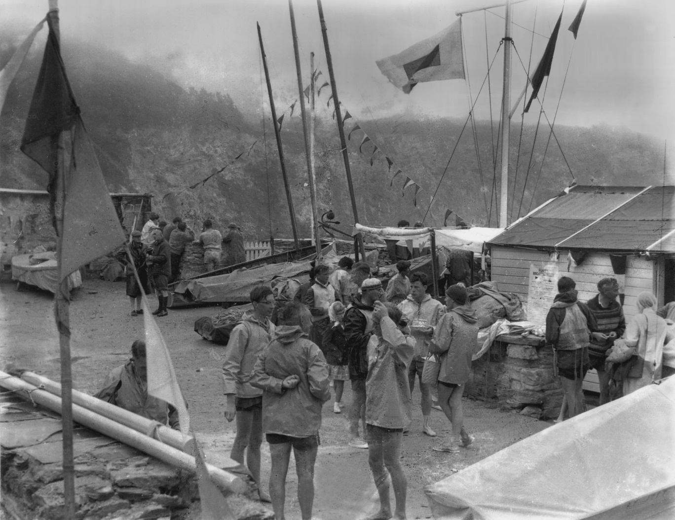
“Is anyone else desperately waiting for the invention of sailing wetsuits? My legs are freezing!”

Slide 17
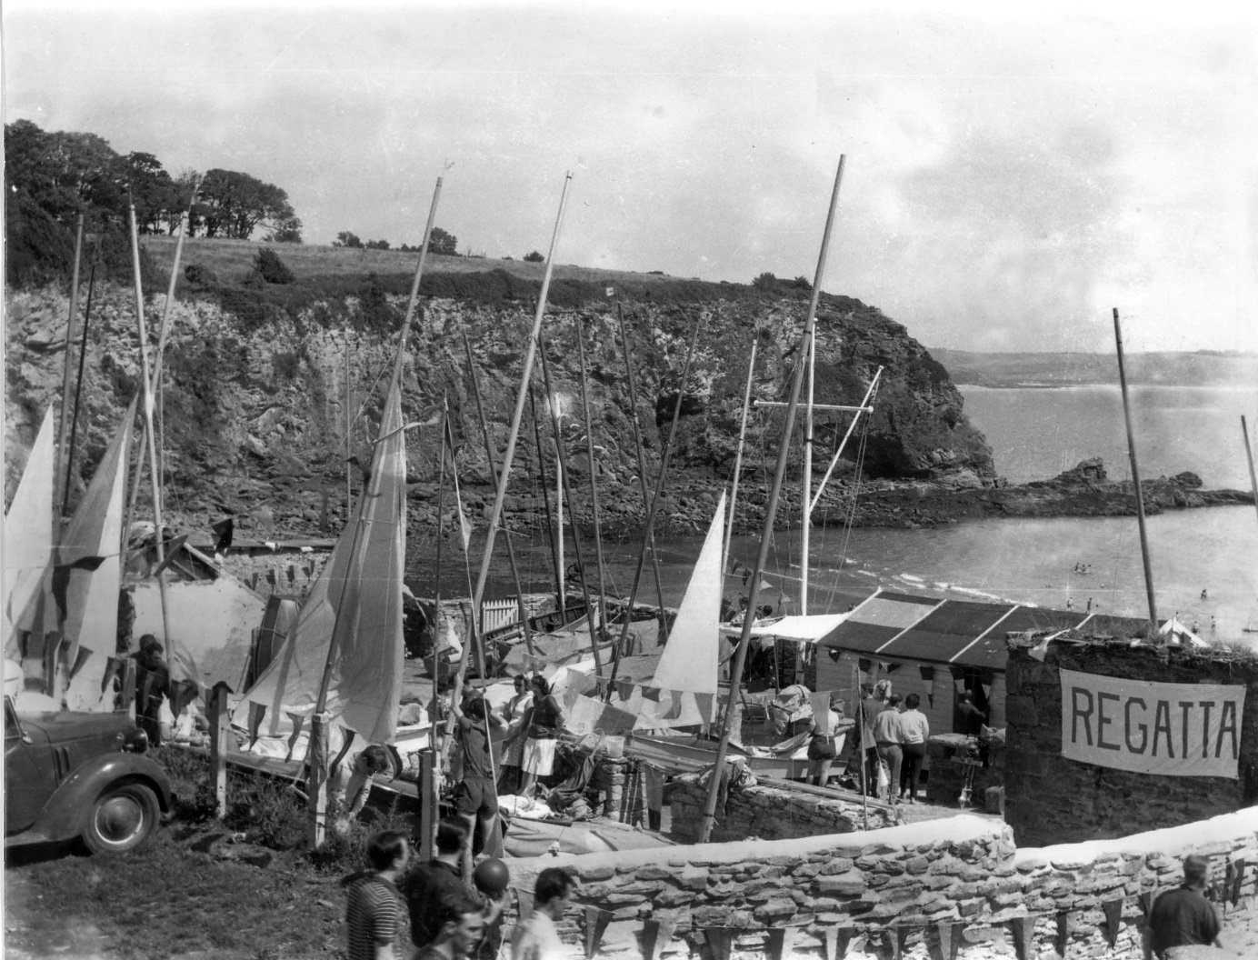
Regatta!!

Slide 18
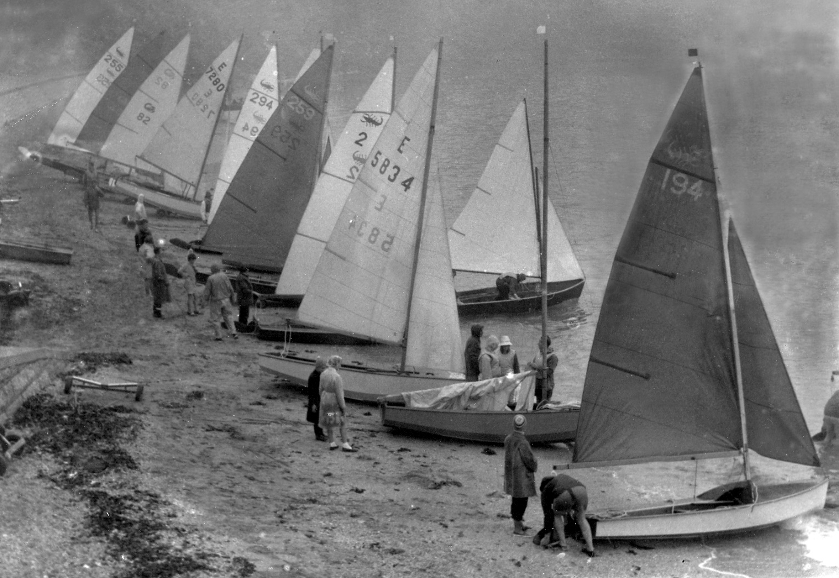

Slide 19
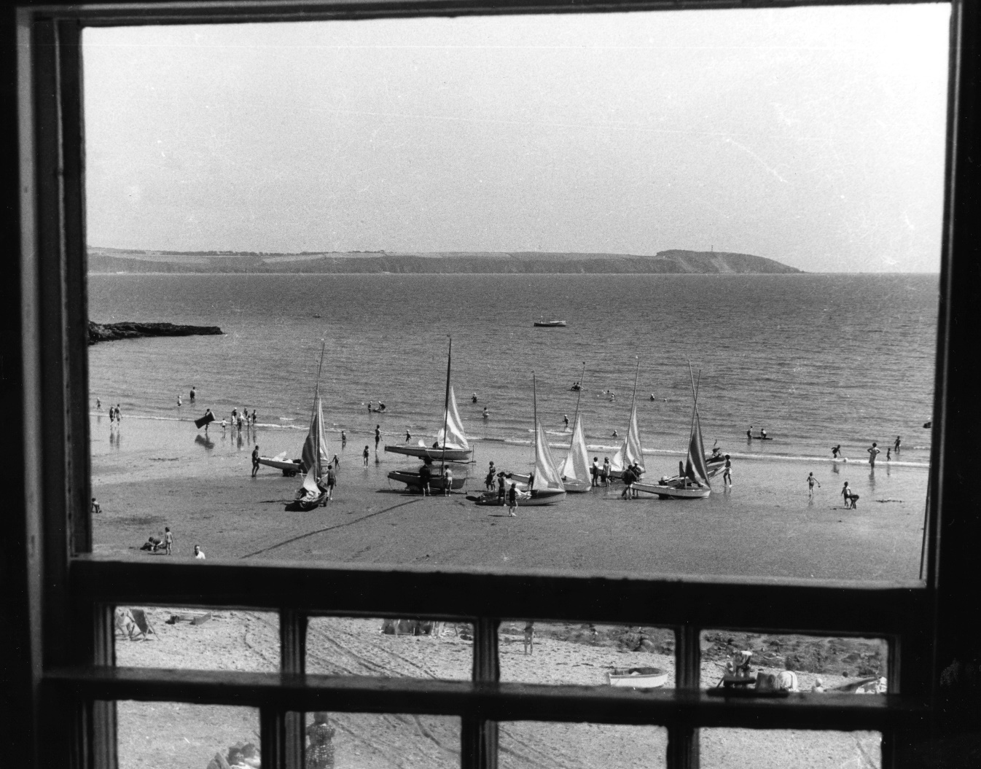
Ospreys from Carlyon Bay SC joining in….

Slide 20
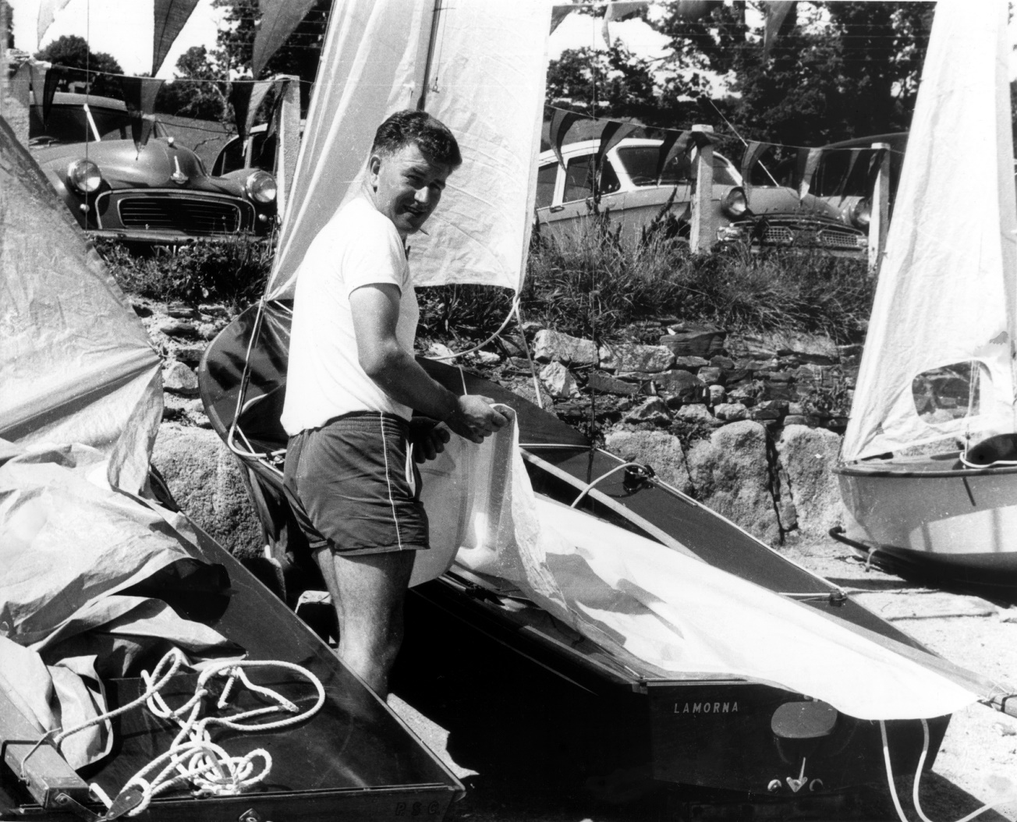
Split windscreen Morris Minor!! Oh and a Scorpion… Can anyone put a name to this chap?

Slide 21
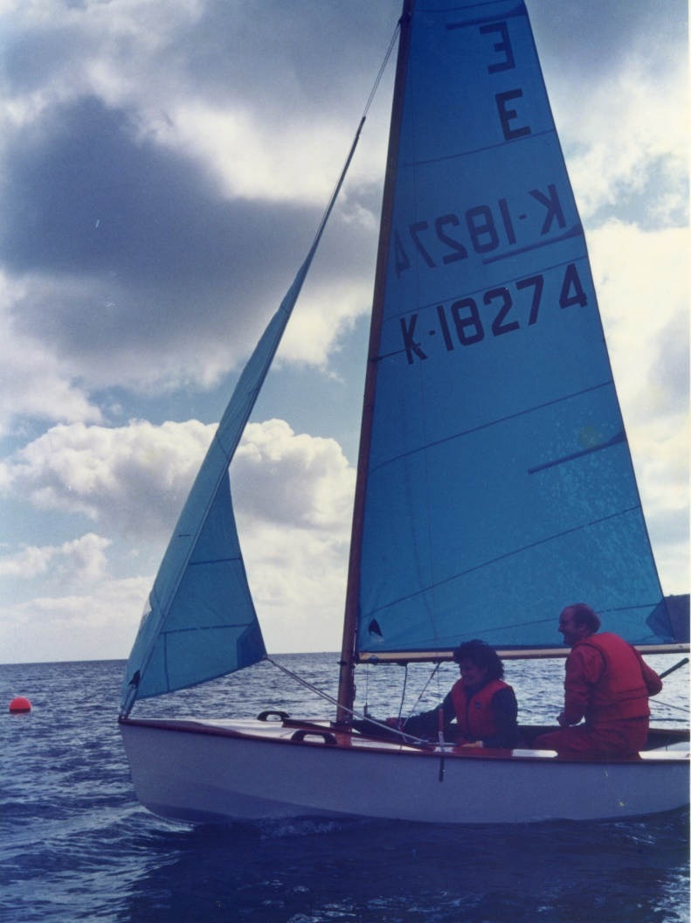
And now in COLOUR – Peter Pope…..

Slide 22
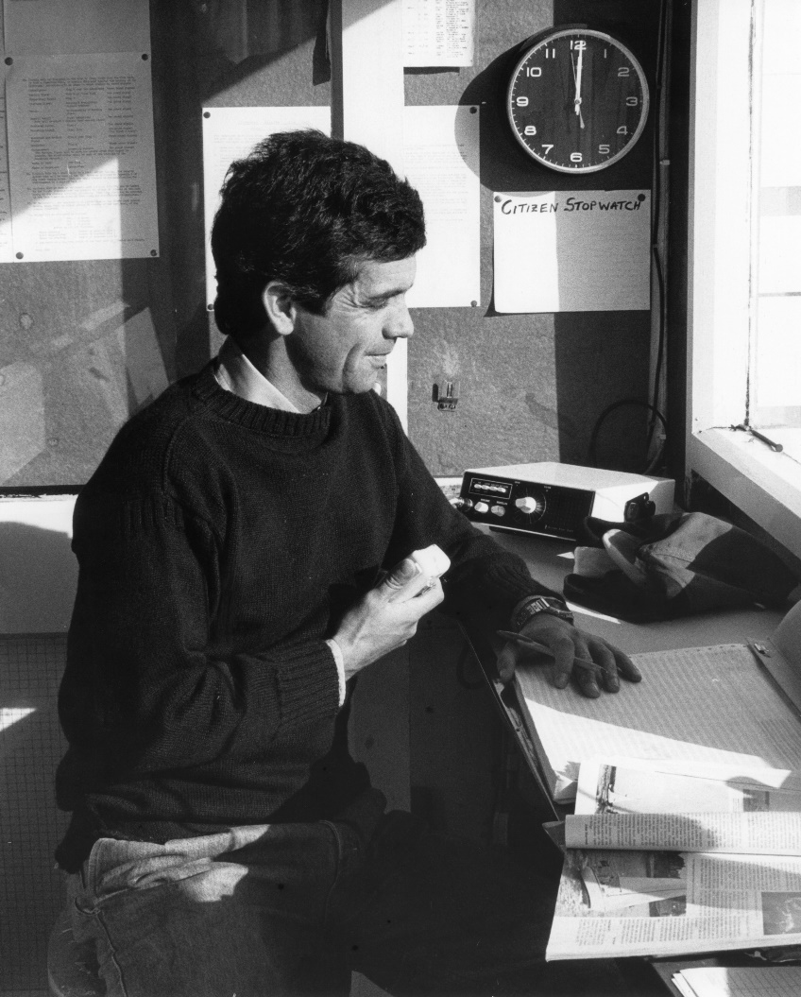
Not in colour – Jeremy Rowett

Slide 23
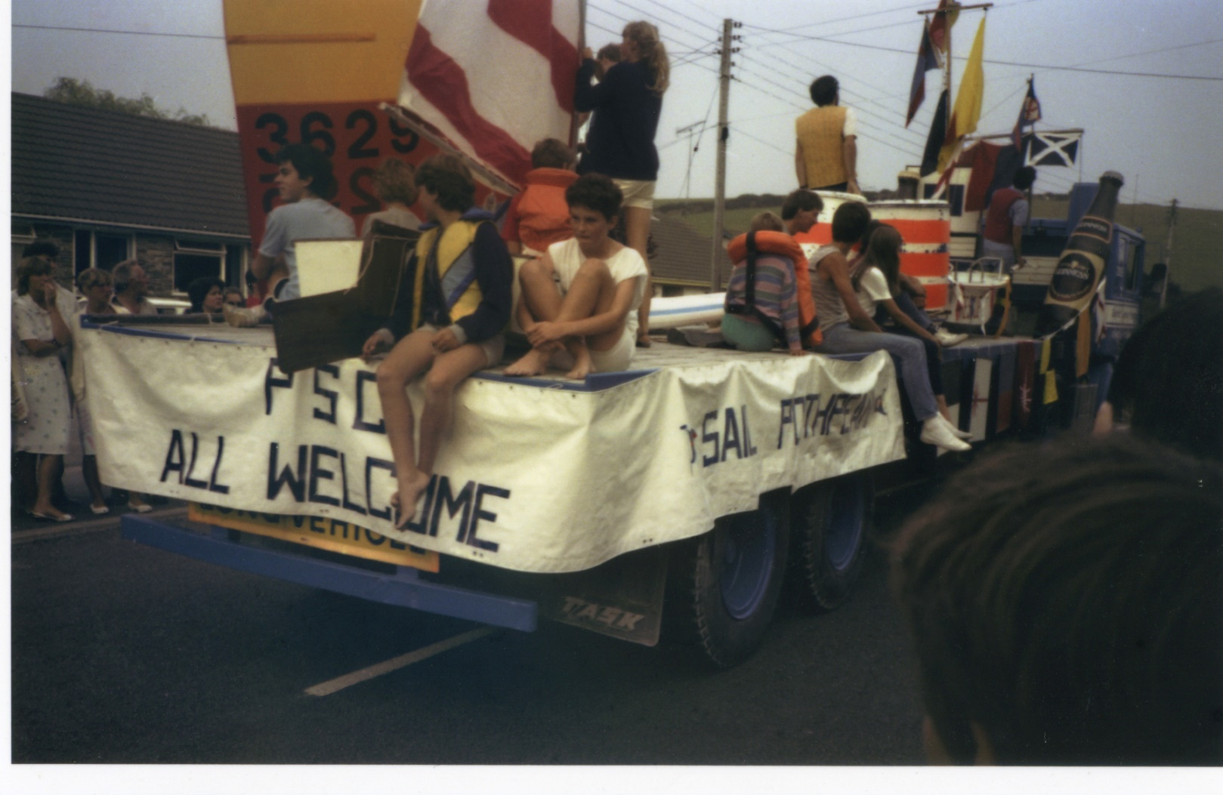
Teenagers! – not looking at all bored

Slide 24
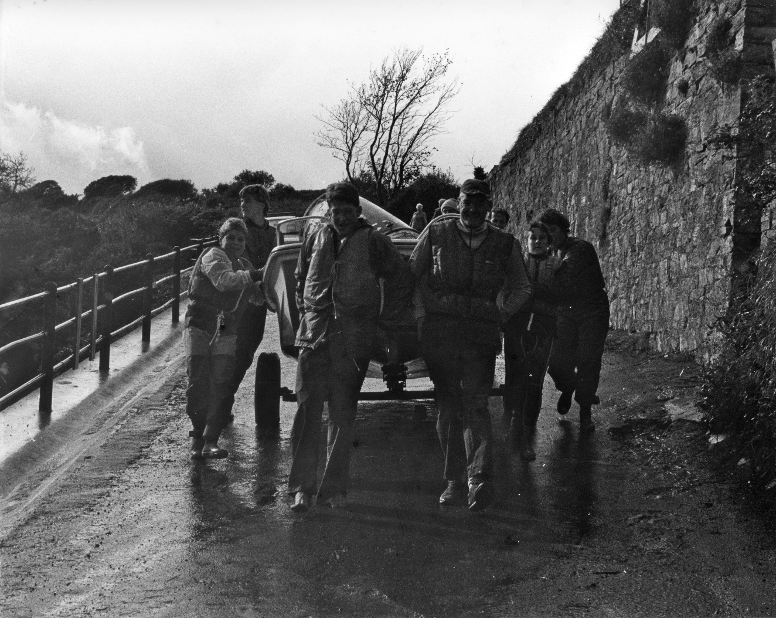
The Dory – UGH!!

Slide 25
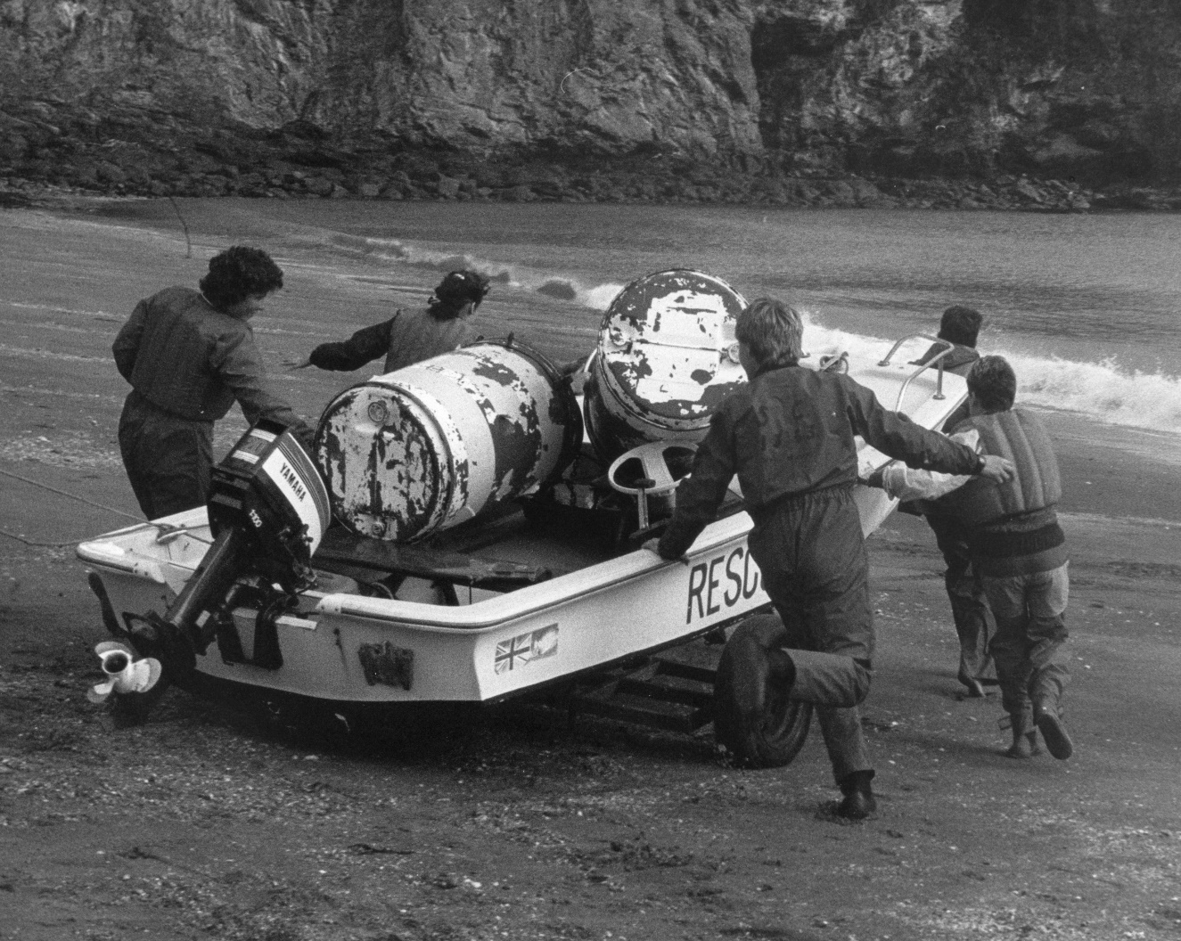
Nice solid racing marks

Slide 26
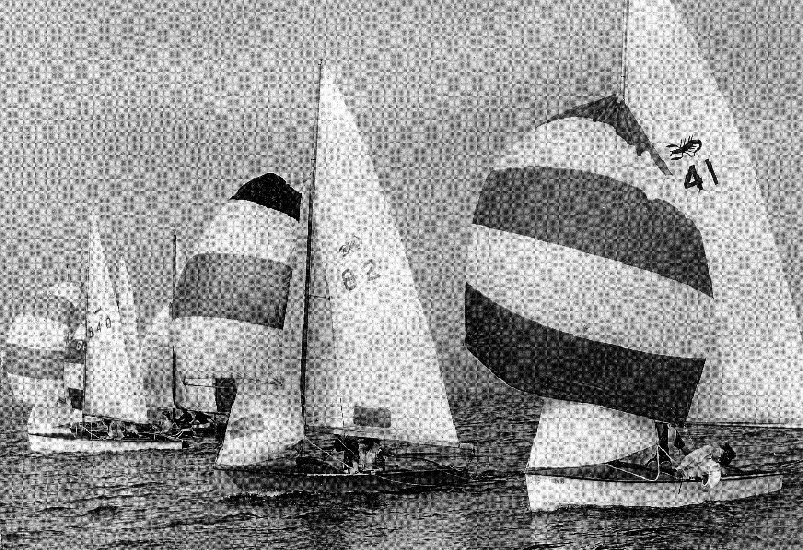
Scorpions – after they added the spinnaker

Slide 27
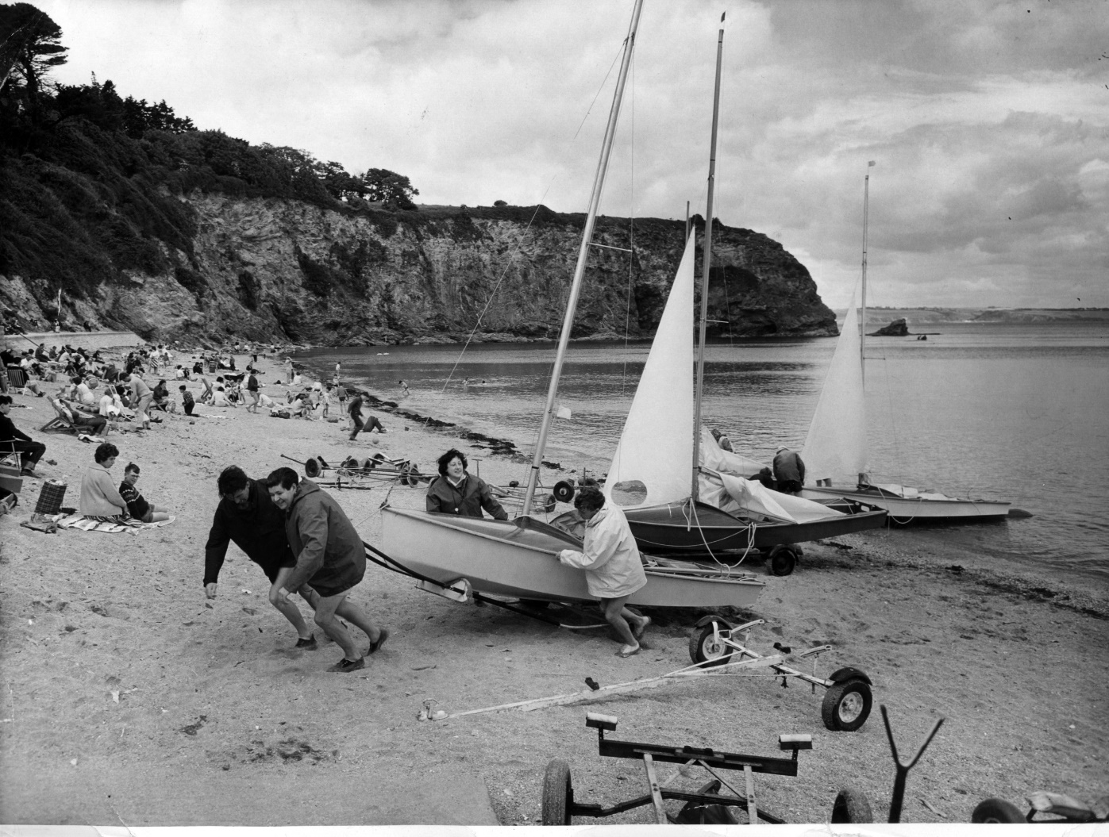
Heave!!

Slide 28
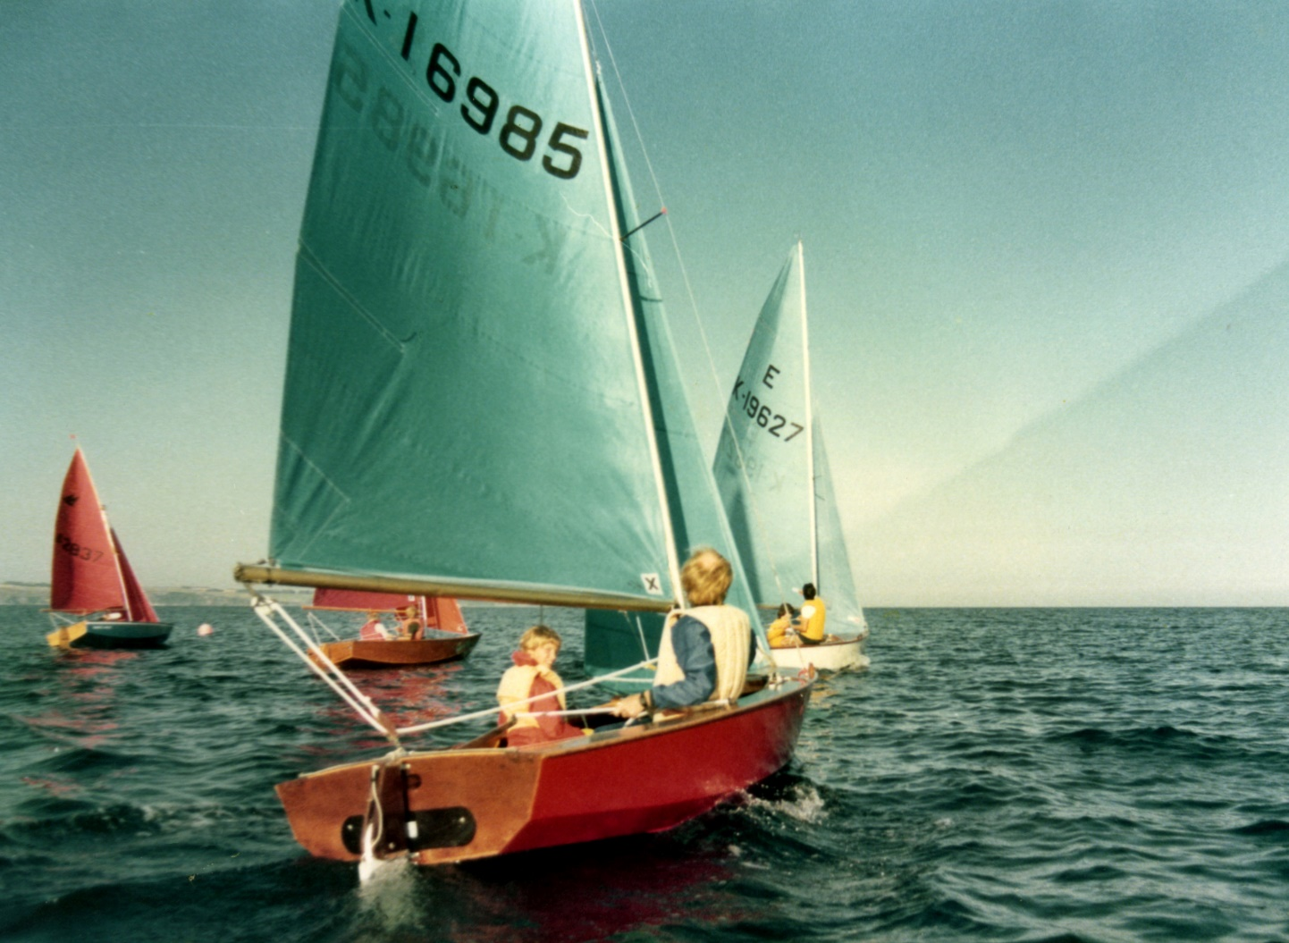

Slide 29
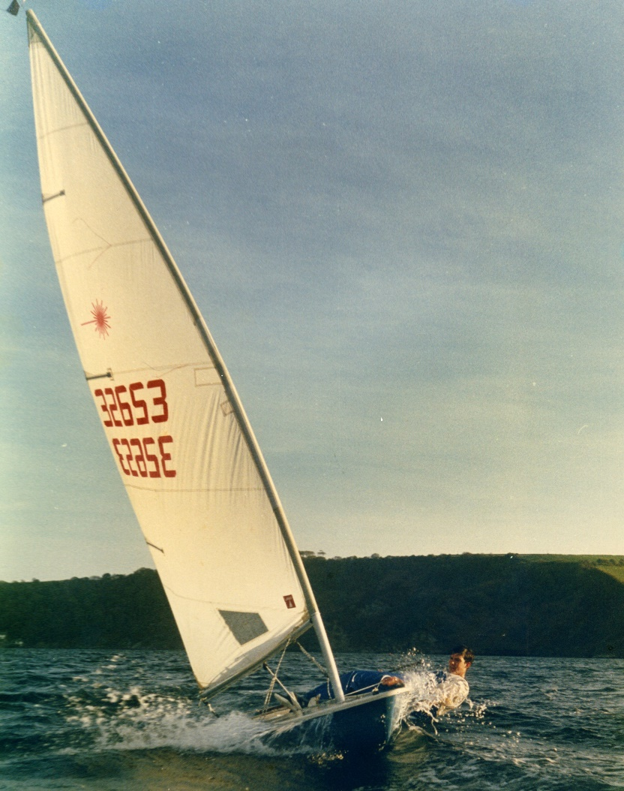

Slide 30
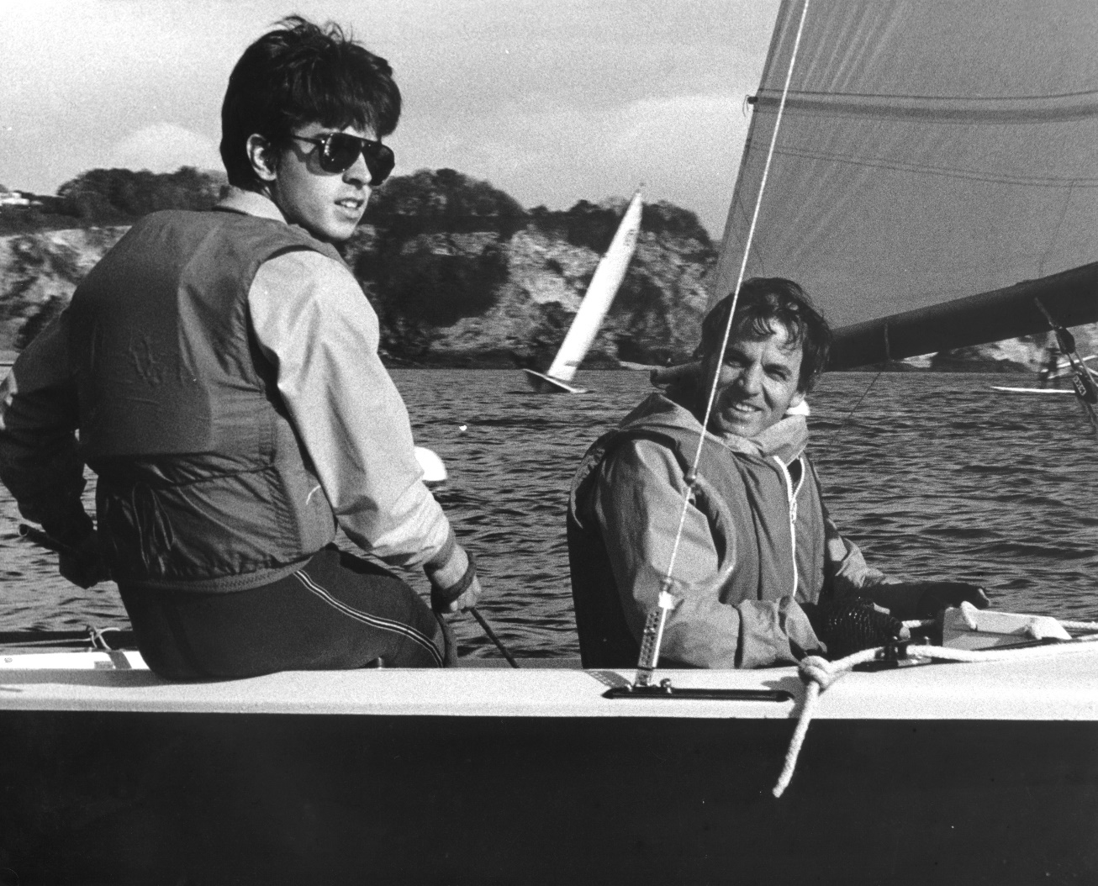

Slide 31
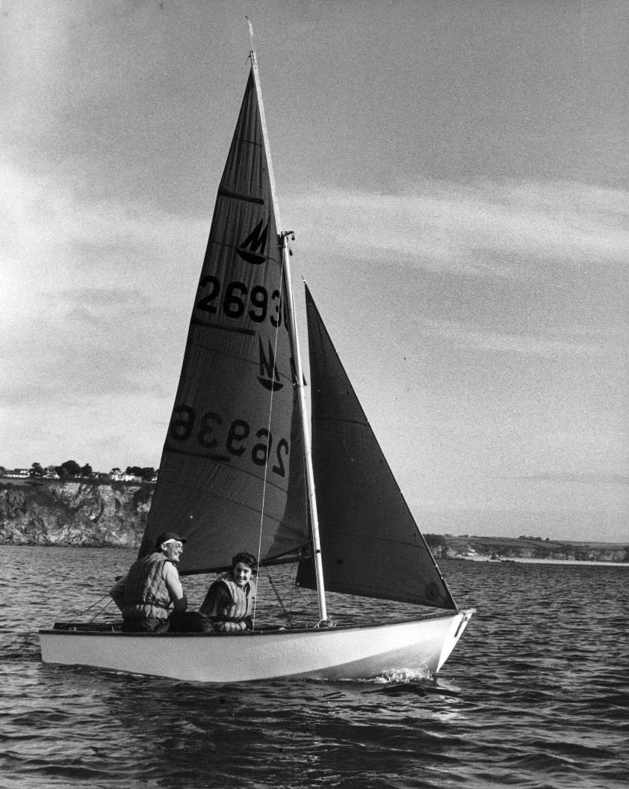

Slide 32
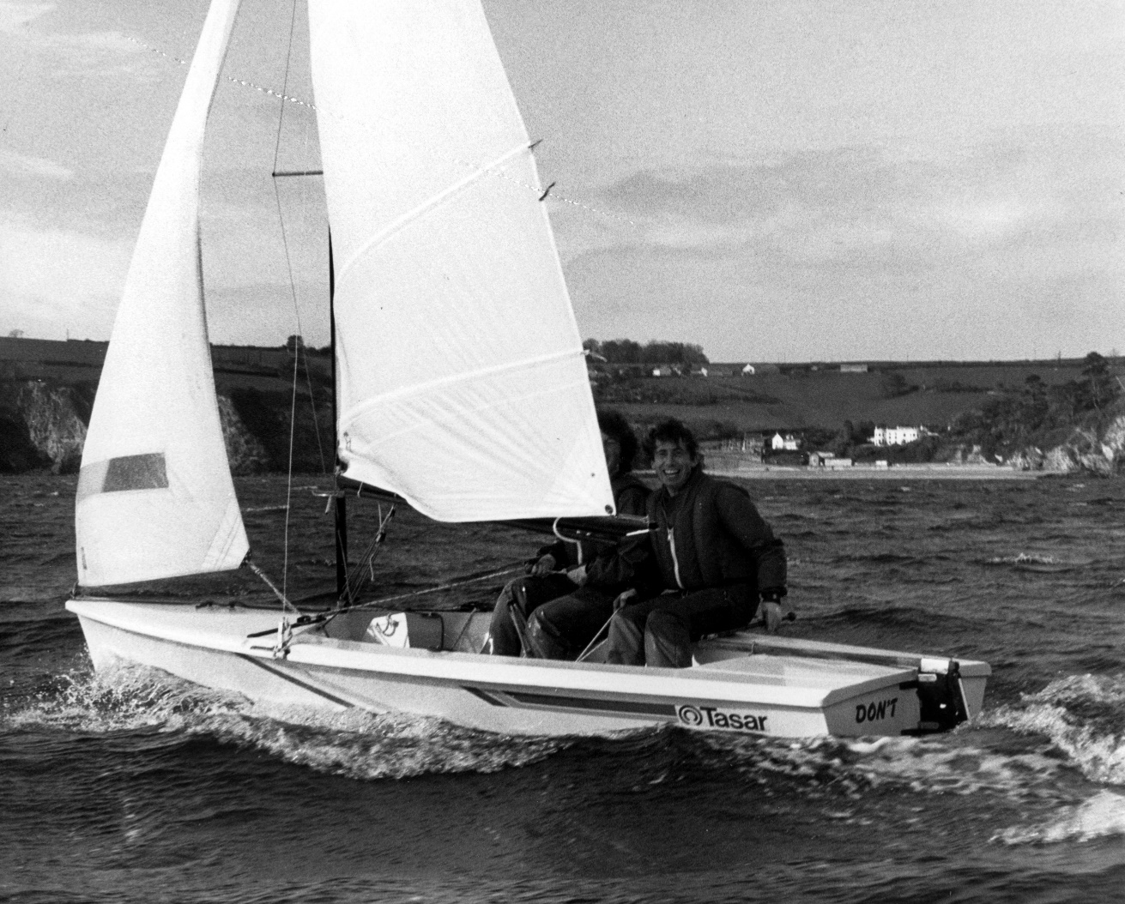

Slide 33
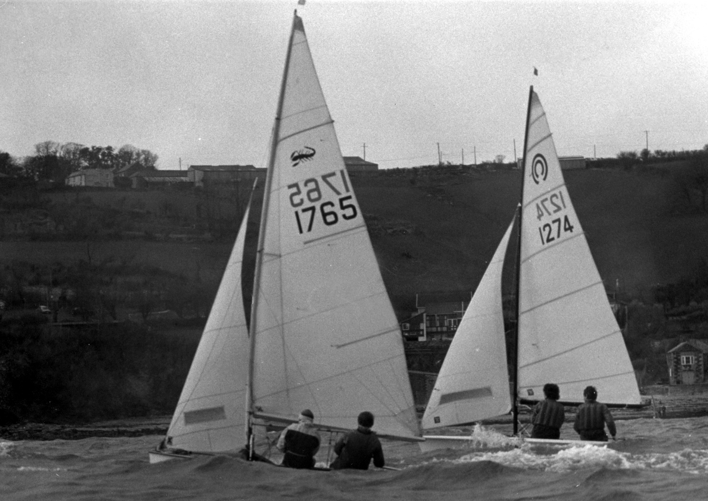

Slide 34
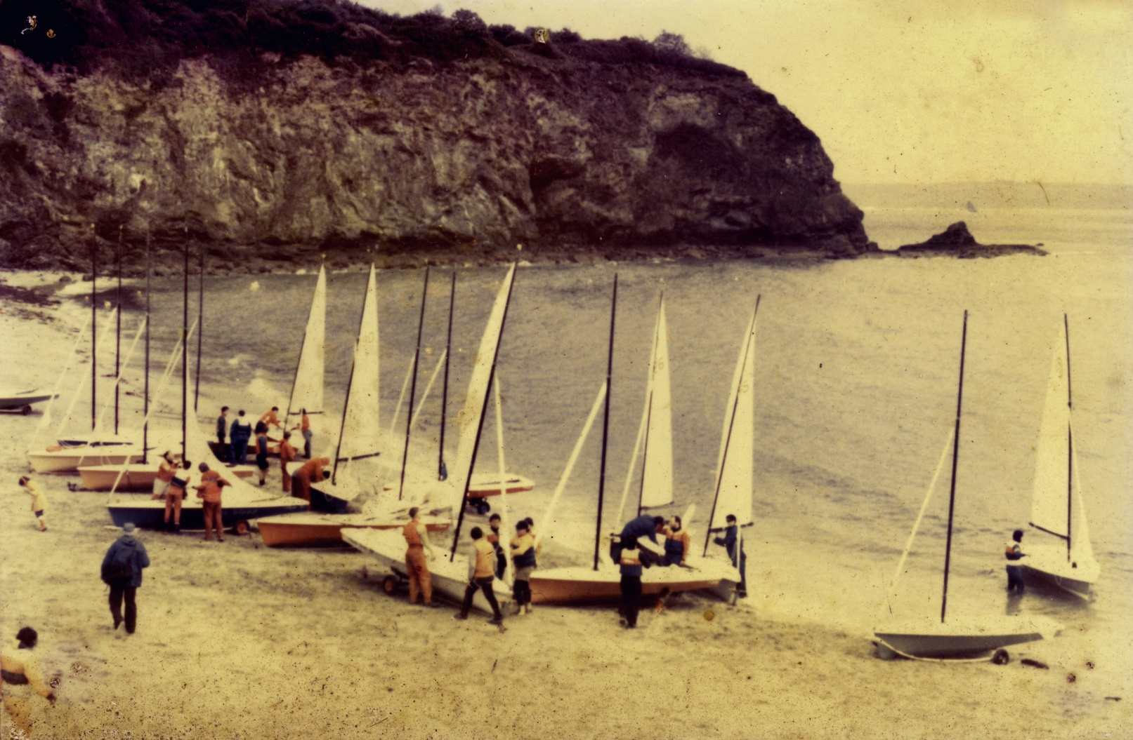
Tasar Open - I assume

Slide 35
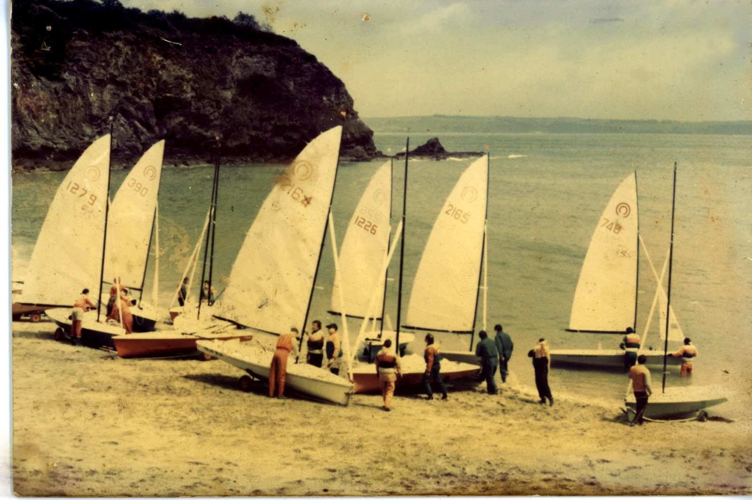

Slide 36
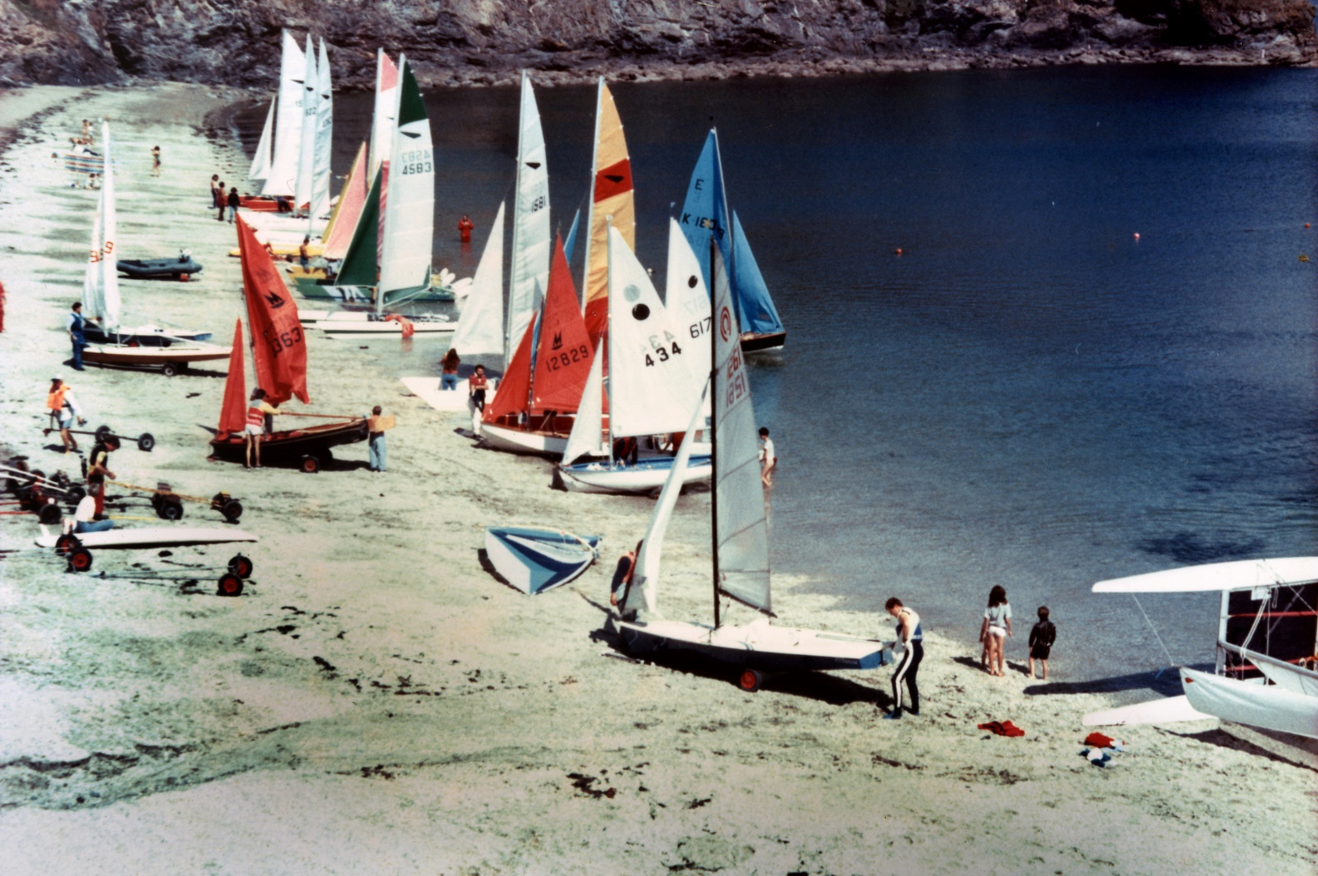
Otters!! You don’t see those around any more – oh and some Darts...

Slide 37
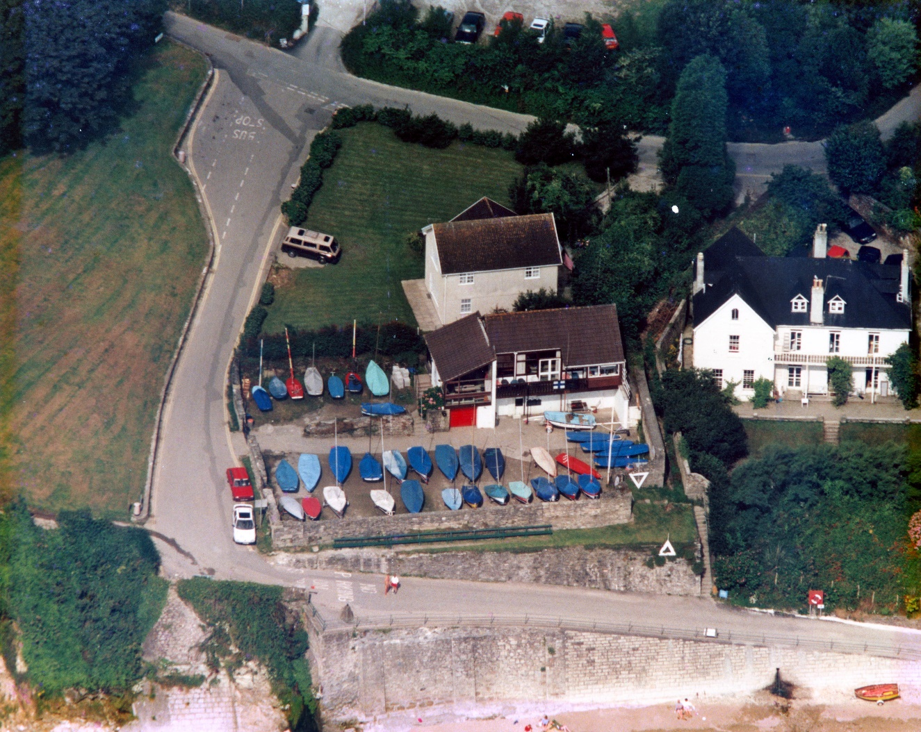
Old balcony, old O.O.D. box, no decking….

Slide 38
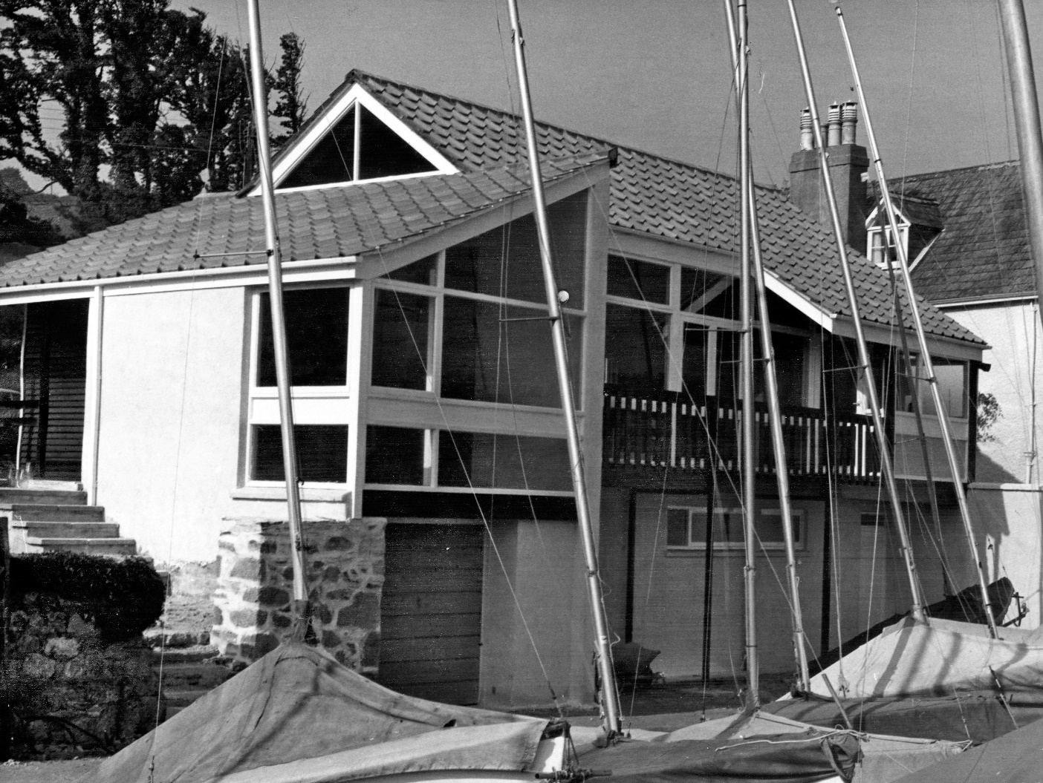

Slide 39
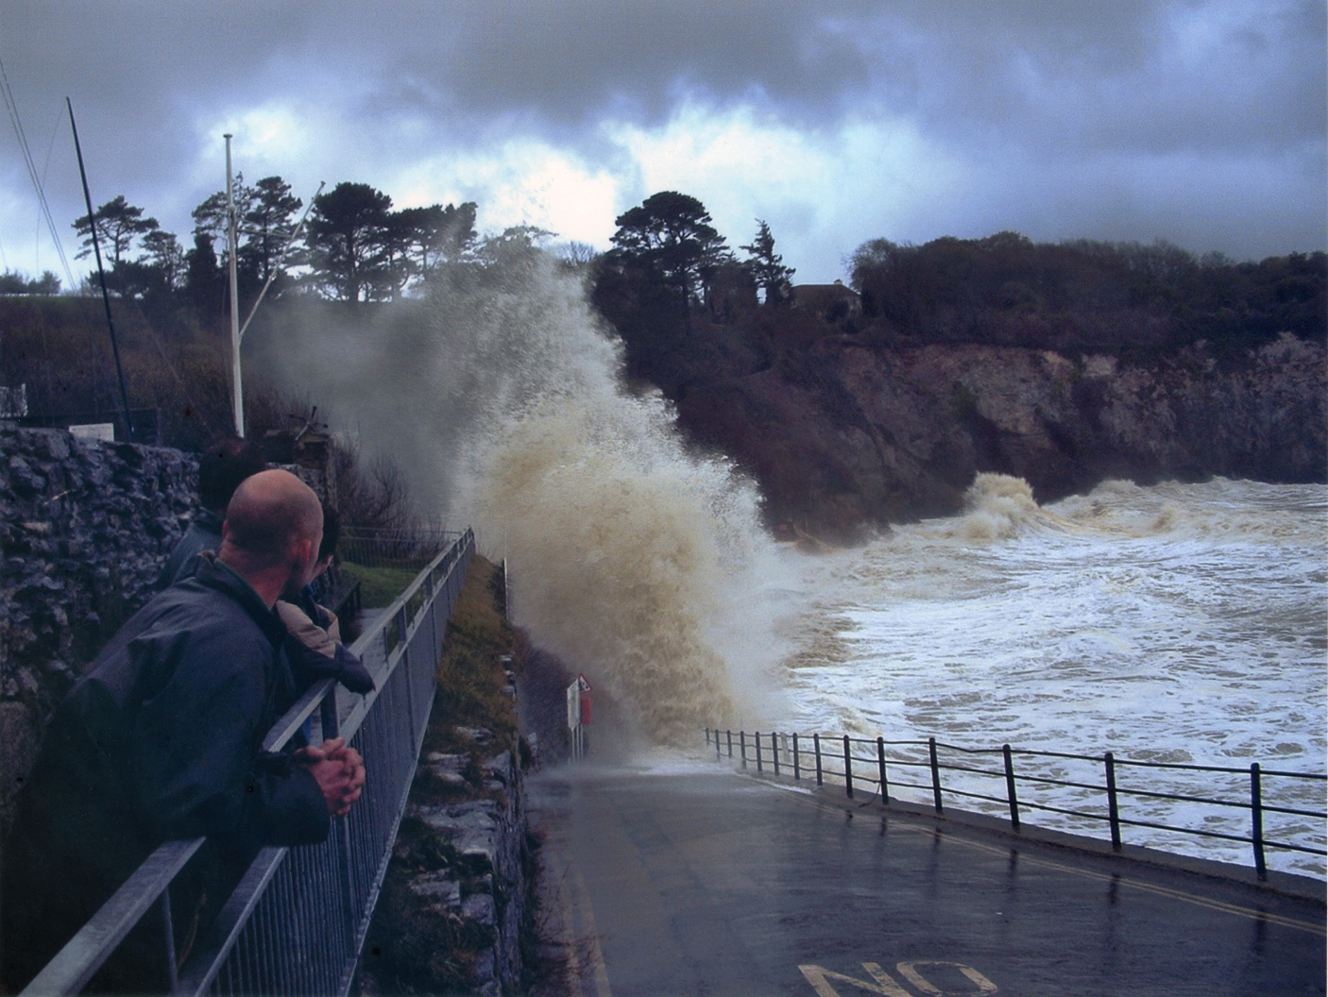
The 2004 storm – “Of course in the old days we’d have launched through that…...”

Slide 40
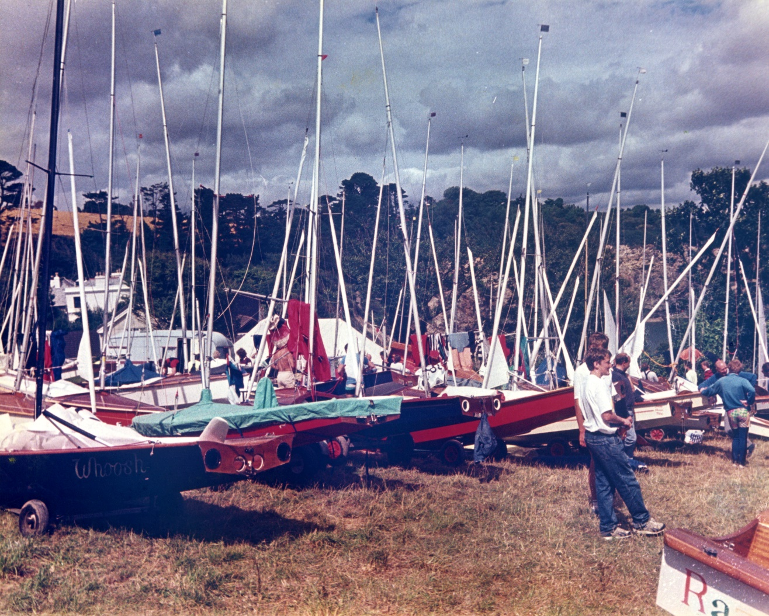
Scorpion Nationals – 1989

Slide 41
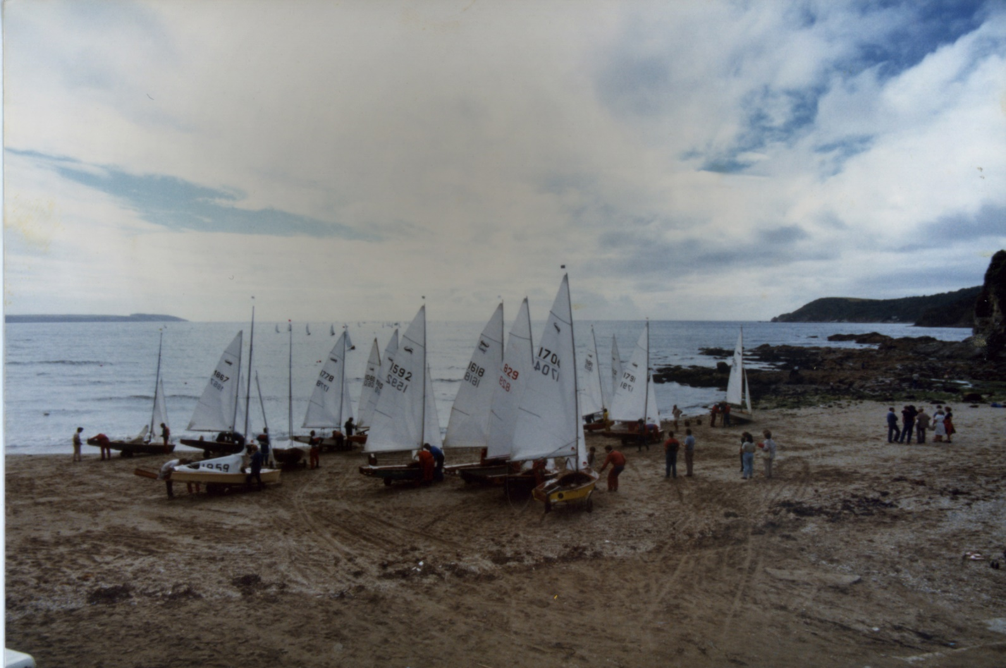

Slide 42
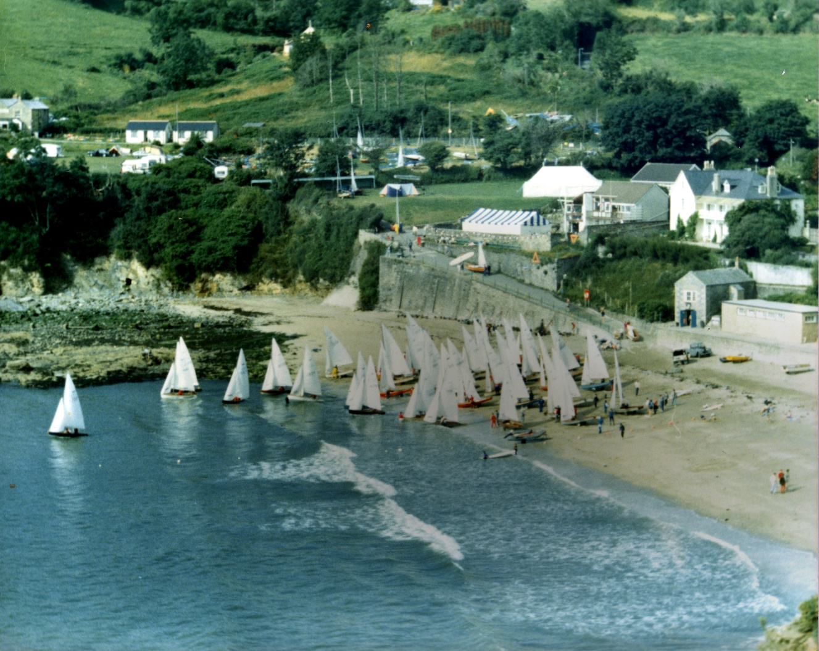

Slide 43
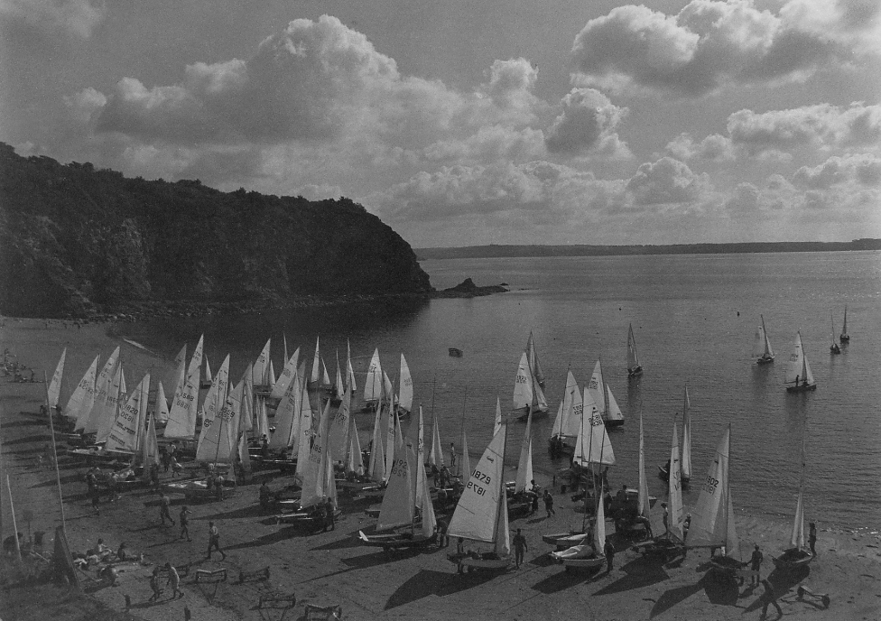

Slide 44
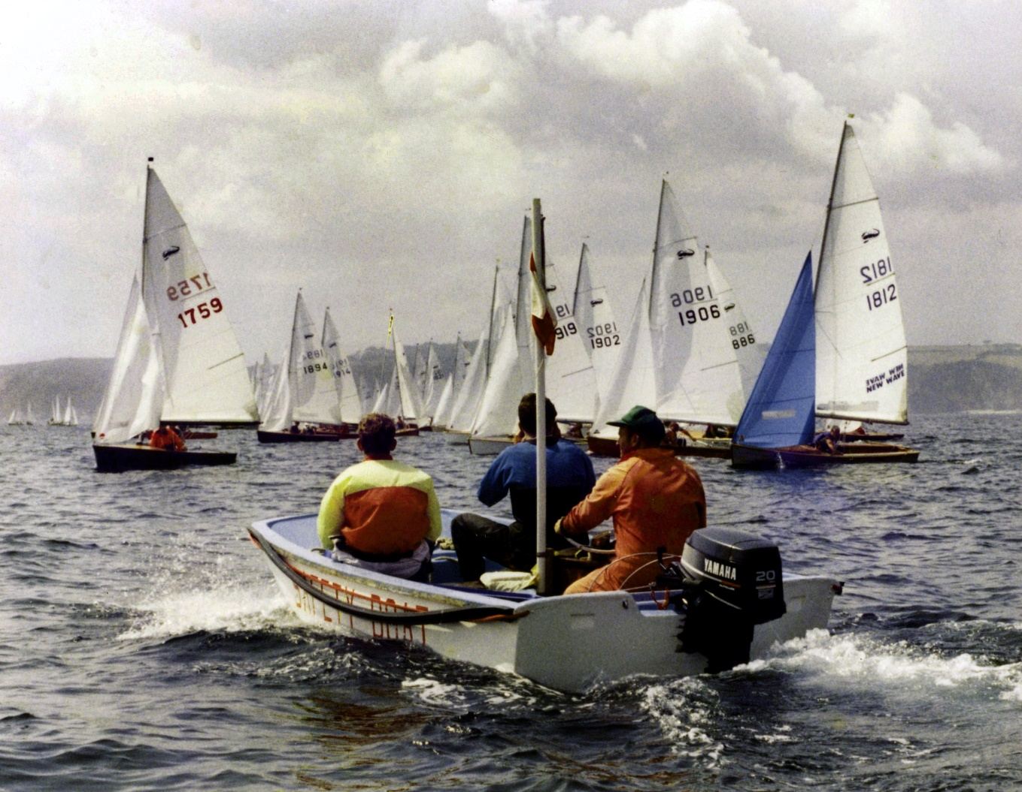
1759 could be in a spot of bother..

Slide 45
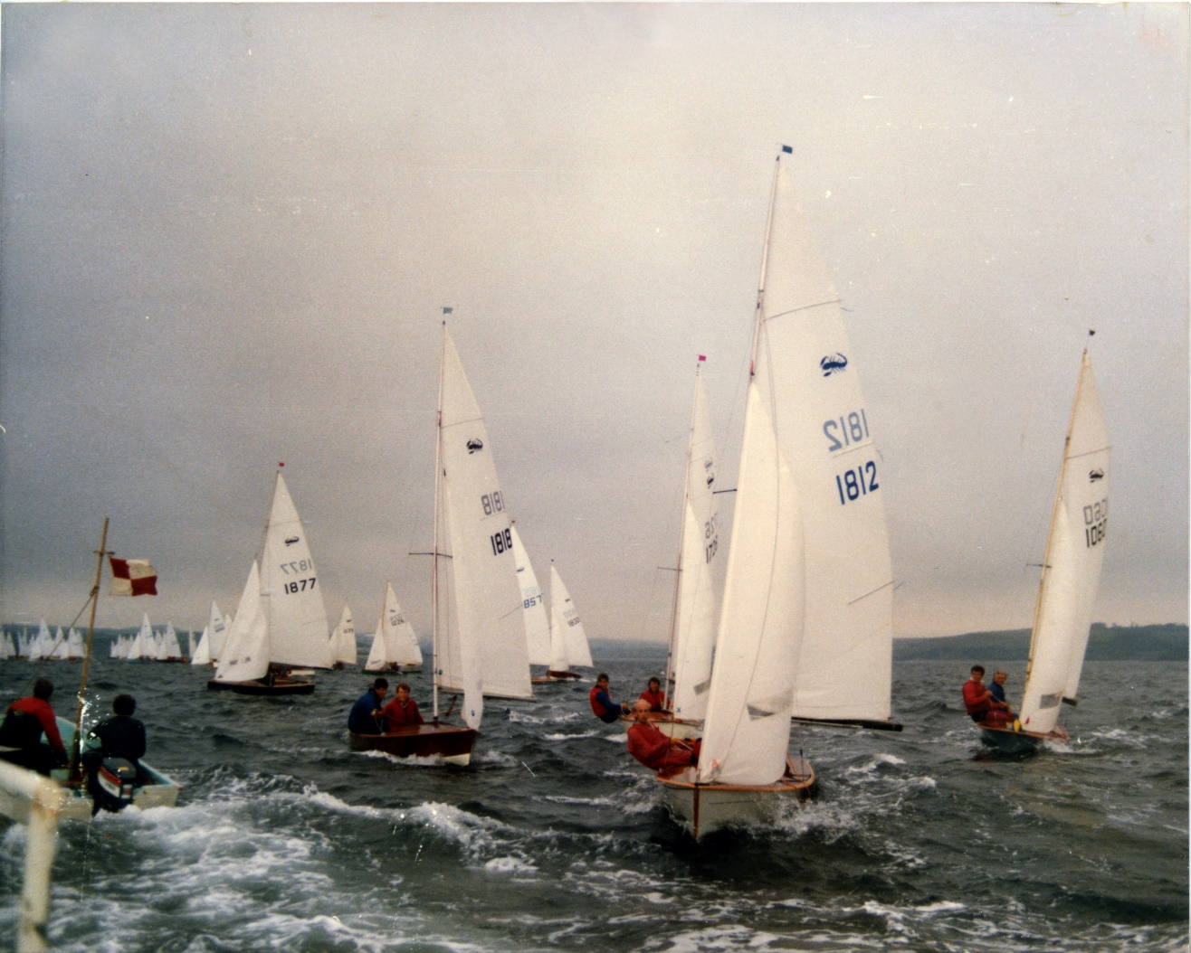

Slide 46
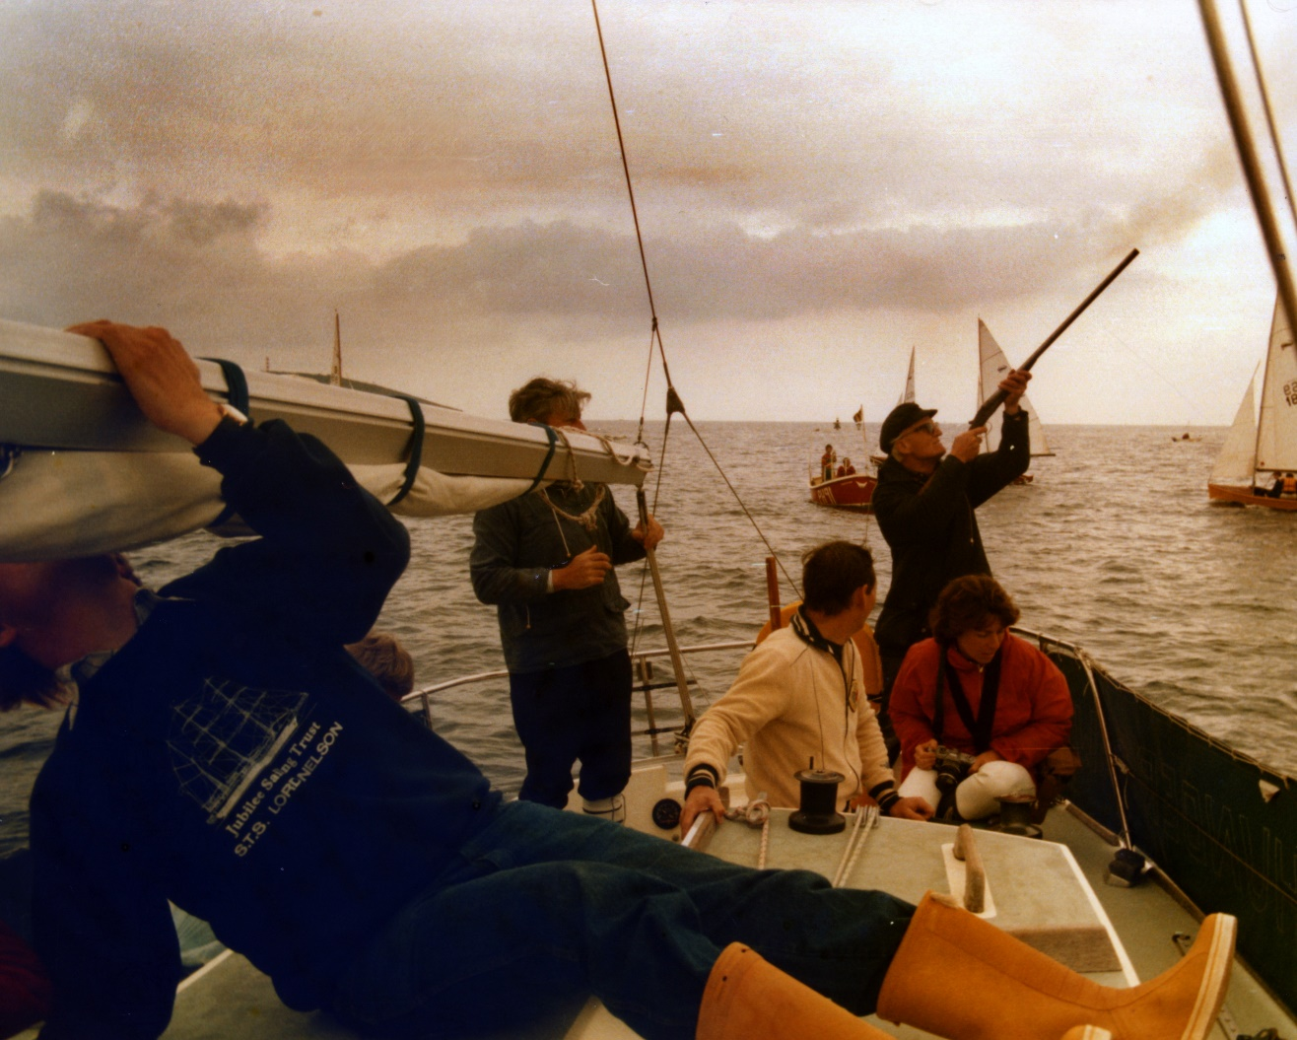
I do hope he’s using blanks – but I have seen a race officer run out and use live shot instead….

Slide 47
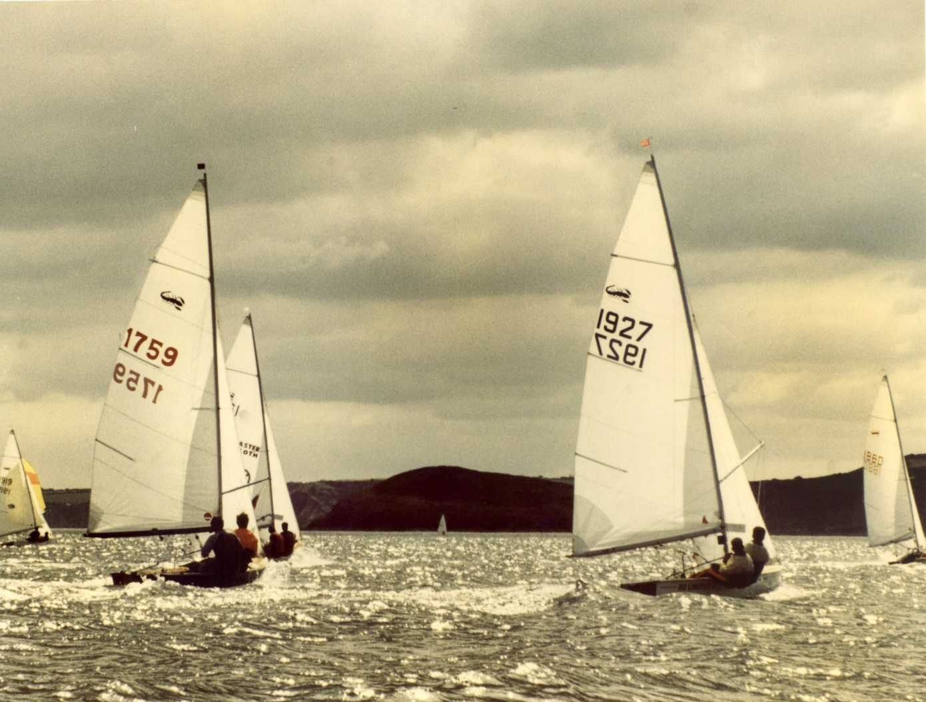

Slide 48
